Slide 1



SAP BTP CAPM Training
www.anubhavtrainings.com
Anubhav Oberoy
Design | Develop | Package | Deploy Cloud Native
Applications and Extensions (Clean-Core)

Slide 2

Agenda
Who is this training for ? |  | 1
What is SAP BTP Platform & CAPM |  | 2
Career Prospects |  | 3
Live Demo |  | 4
Q&A and Call-to-Action |  | 5
An end-to-end course for Solution Architects, developers, SAP Consultants, Technical Advocates
ANUBHAV TRAININGS

Slide 3





www.anubhavtrainings.com
Who is this course for?
ABAP Developer-
Sumit Ghosh
Deliver new innovations that natively integrate with SAP applications like S/4HANA (Side by Side Extensions) on SAP BTP
Any Technical Consultant-
Neha Joshi
Work faster with latest development tools like Business application Studio and Frameworks like CAPM with Node JS.
BTP Developer-
Stevia Jack
Developing Applications Running on SAP BTP Using SAP HANA Cloud, Java and Node JS.
SAP Administrator-
Mohan Grava
Learn the security and administration of SAP BTP Cloud Applications. Understand connectivity basics and manage Central Fiori Launchpad in BTP.

Slide 4

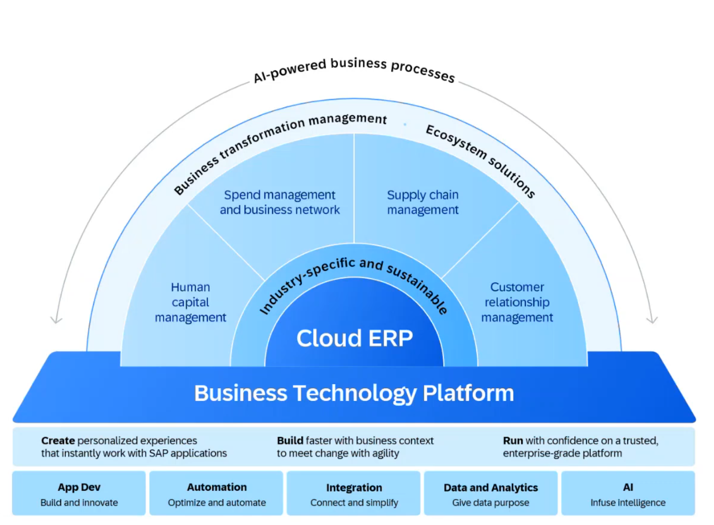

What is SAP BTP
www.anubhavtranings.com
5

Slide 5



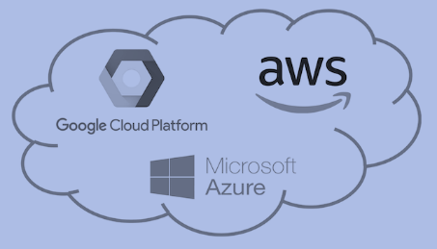
Why we need SAP BTP?
Application
Application
Data
Data
Runtime
Platform as a Service
Managed by SAP implementing open source CF
Middleware
Fully ready landscape with reusable services
Scalability
Elasticity
Low TCO
Database
OS
Managed by Infrastructure
providers
Data Centers
Service Portfolio
Virtualization
Infrastructure as a Service
Servers
Storage
Networking
www.anubhavtrainings.com

Slide 6


Anubhav
Trainings
Career Prospects
Grow your career
Market Demand Explosion: The SAP Cloud market is expected to exceed $150 billion by 2030, with SAP BTP enabling enterprise cloud solutions for over 400,000 companies worldwide. This represents massive career opportunities for skilled professionals.
Hot Job Roles: Companies like Mercedes-Benz, Big 4 consulting firms, Fortune 500 enterprises, and SAP partners are actively recruiting BTP CAPM developers. Roles include Cloud Application Developer, BTP Integration Architect, SAP Extension Specialist, and Full-Stack BTP Developer.
Cutting-Edge Technology Stack: Learning BTP CAPM means mastering Node.js, CDS (Core Data Services), SAP Fiori/UI5, Cloud Foundry, PostgreSQL, microservices architecture, and CI/CD pipelines—skills that position you at the forefront of enterprise cloud development.
Future-Proof Career: Digital transformation initiatives across finance, manufacturing, healthcare, and technology sectors are driving unprecedented demand for BTP expertise, making this skillset resilient to market fluctuations.
Niche Specialization Advantage: BTP CAP Development proficiency is essential for organizations aiming for a connected landscape, and there's a shortage of professionals with specialized BTP skills, giving you a competitive edge.
Salary Insights & Increments
US Market - Impressive Ranges: The average annual salary for SAP BTP professionals in the United States is $148,509, with the majority earning between $130,500 (25th percentile) to $173,500 (75th percentile). Top earners make $186,500 annually (90th percentile).
Consultant Premium: SAP BTP Consultants command an average of $137,214 per year, with the highest earners reaching $242,879.
India Market Growth: Professionals report starting salaries of 15 lakhs (fixed + variable) with stocks of around 1 lakh INR yearly at SAP Labs, with BTP consultant roles at Big 4 firms offering 20-25 LPA.
Join the course
Notes:
AI generated images

Slide 7
What is CAPM?
Anubhav Trainings
Development Model based on CDS
Database Agnostic with Latest Frontend technology
The SAP Cloud Application Programming Model is a framework of languages, libraries, and tools for building enterprise-grade services and applications. It is a strategic long-term solution for cloud-native application development on BTP platform based on microservices.
Framework Libraries
@sap/cds, @sap/cds-dk
Tools
VS code & BAS
Language
Node JS and Java

Slide 8
What we do today?
Anubhav Trainings
1
2
3
4
Start Dev Tool
Initialize
Create Data Model & Service
Test Locally
Get started with SAP BTP Business Application Studio Tool
Initialize your first BTP CAP project
Build your first data model and service along with sample UI
Test the application and service locally

Slide 9
Travel Data App
Understand
Anubhav Trainings
Understand the data model and requirements
01
You are working in travel industry as a technical developer, your organization collected the travel data of many countries over last couple of years with top tourist locations, you would like to design an application in cloud to present the same data with a report.
Design
Create the project skeleton and models
02
Develop
Develop the application and test
03

Slide 10

New Updated Content
01
Attachments
Understanding support for data attachments using CAPM
Anubhav Trainings
02
Multi-tenancy
Develop and Deploy multi-tenant CAP applications with Data separation
03
SAP Joule
Power the application development with SAP Joule for CAP Developers in Build Code
04
Syntax and Features
New CAP language syntax and features like consume external services and RFCs
Notes:
https://pixabay.com/photos/engineer-code-coding-software-4690505/

Slide 11
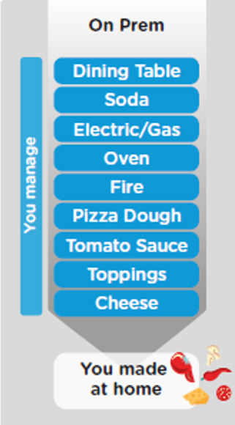
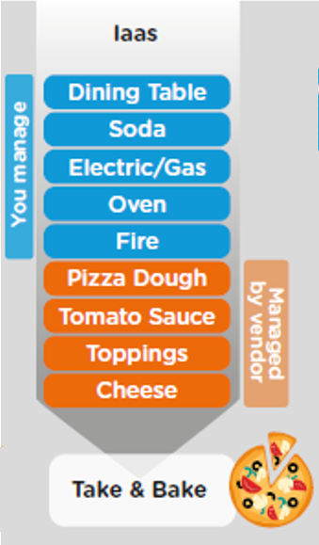
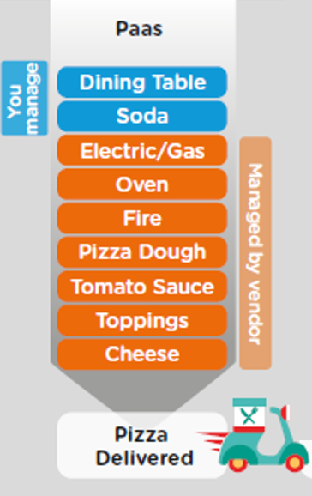
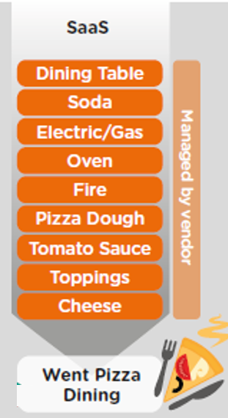
ON-PREMISE V/S CLOUD
www.anubhavtrainings.com

Slide 12
TYPE OF CLOUD OFFERINGS
Application
Application As a Service
Customer Managed
Customer Managed
Customer Managed
SAP Managed
Data
Runtime
Platform as a Service
SAP/Partner Managed
Middleware
Database
OS
Virtualization
Infrastructure as a Service
SAP/Partner Managed
Servers
Storage
Networking
www.anubhavtrainings.com

Slide 13
WHAT IS SAP CLOUD FOUNDRY?
Application
Application
Data
Data
Runtime
Platform as a Service
Managed by SAP implementing open source CF
Middleware
Fully ready landscape with reusable services
Scalability
Elasticity
Low TCO
Database
OS
Managed by Infrastructure
providers
Data Centers
Service Portfolio
Virtualization
Infrastructure as a Service
Servers
Storage
Networking
www.anubhavtrainings.com

Slide 14
What is SAP BTP?
SAP BTP is a Platform As A Service (PaaS) by SAP where the Infrastructure is provided by SAP partners (GCP, AWS, Azure). The platform can be used by development teams to design, develop, package, deploy, and manage end to end cloud applications (SaaS) for the business users.
The advantage of this platform is Scalability, Elasticity, Lower TCO. BTP is not just only used by development teams to develop applications but can be used to perform
Analytics
Integration
AI Scenarios
Process Development and orchestration
Data mining and data warehousing
SAP make their own SaaS solutions based on top of BTP. E.g. CALM, Joule, SAC, Success Factors, S/4HANA Cloud, Datasphere.

Slide 15

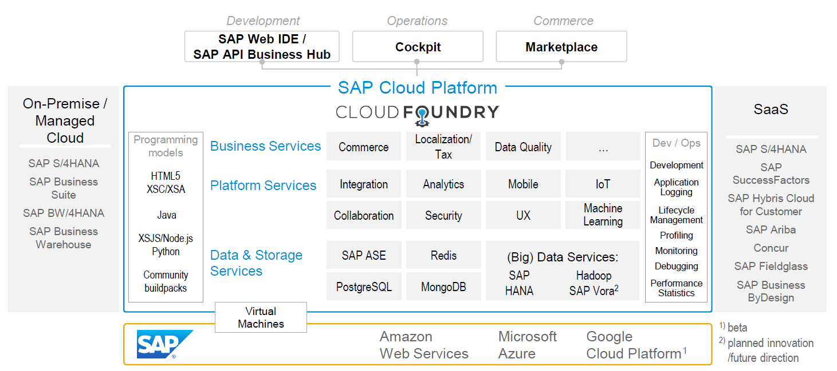
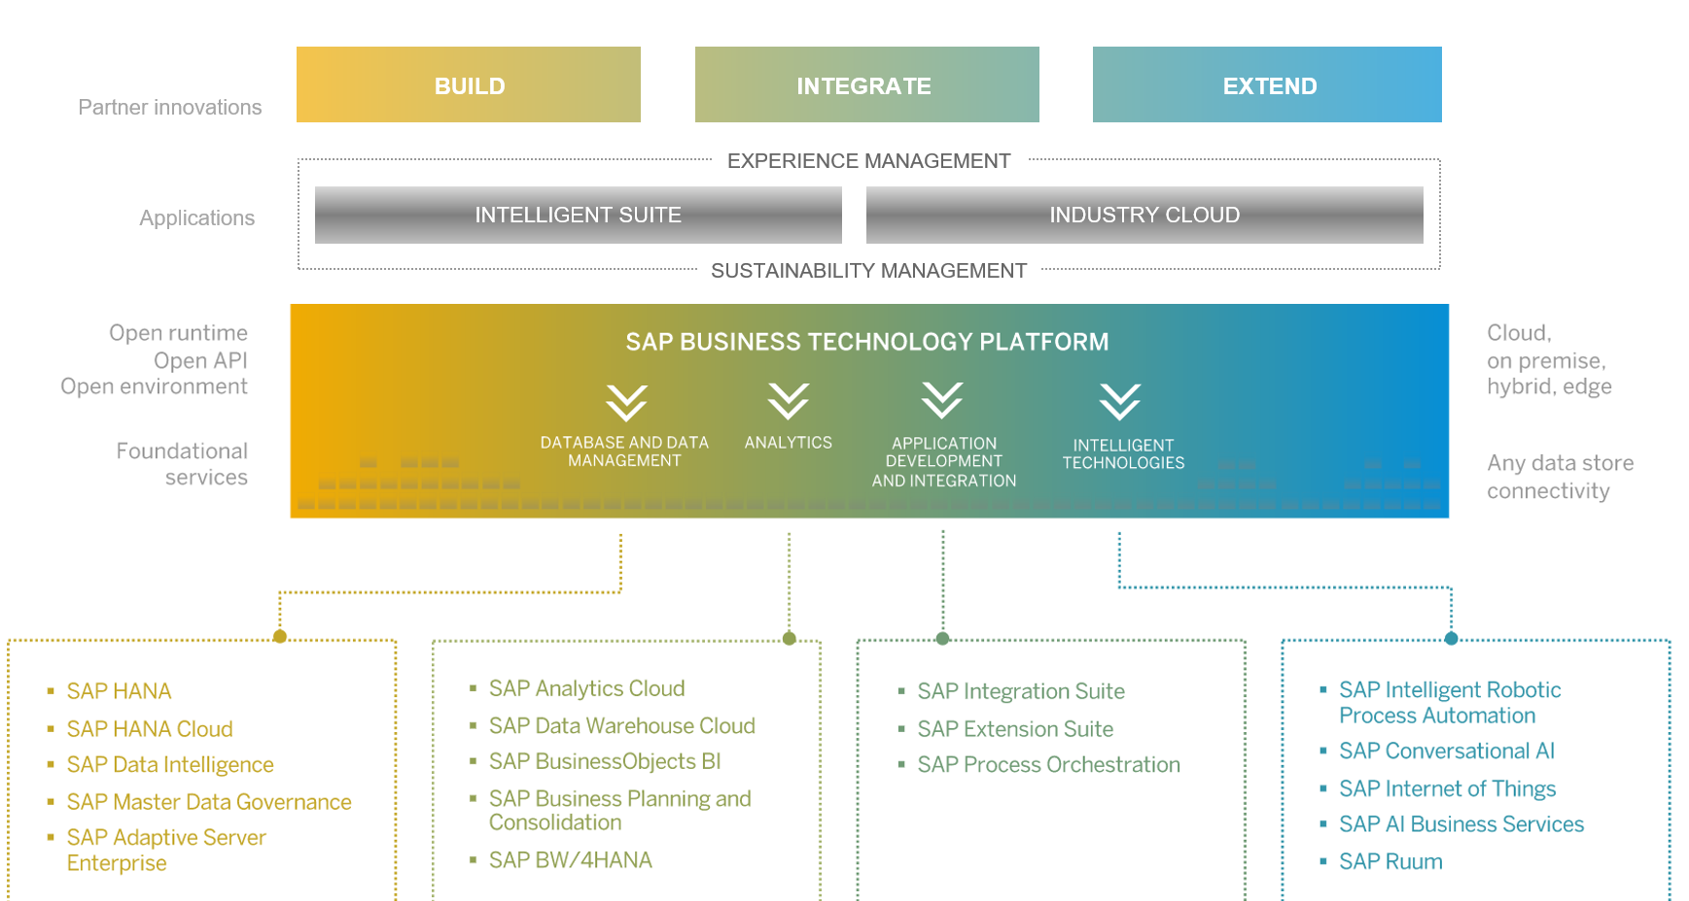
SAP BTP Overview
11
www.anubhavtrainings.com

Slide 16
SAP CLOUD FOUNDRY ARCHITECTURE
SAP Business Application Studio
www.anubhavtrainings.com

Slide 17

Why CF (1)
1
Support full development lifecycle
Build Application & Services
Development
Continuous Delivery (CD) = Code 🡺 Push 🡺 Test 🡺 Build
Continuous Integration (CI) = Dev 🡺 Quality 🡺 Production
Up and Down
Deployment
Testing
Monitor and Upgrade
www.anubhavtrainings.com

Slide 18



Why CF (2)
2
Self healing container management system
Cell
Garden = execution
Containers
A
www.anubhavtrainings.com

Slide 19
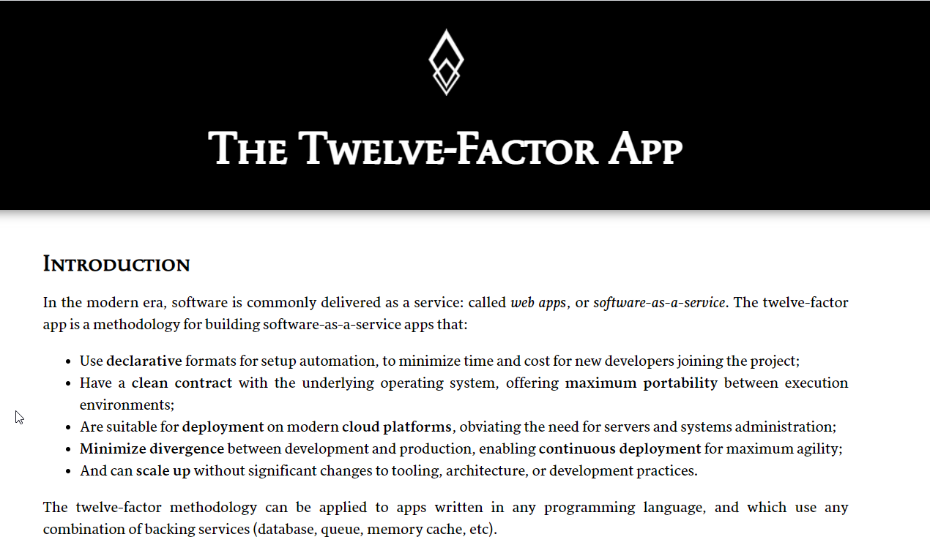
Why CF (3)
3
Support 12 Factor App
It is a strategy to build software-as-a-service
https://12factor.net/
A
www.anubhavtrainings.com

Slide 20
History of CF
License: Apache 2.0
Build in Ruby, Java and Go
Open Governance Foundation
2009-2011
2012
2013
2014
2015
2019
2021
VMWare
BOSH
Open Source Tools
Seven platinum members and two gold members
40+ Members
65+ Members
Jan 2021
Pivotal Cloud foundry closes free trials
Pivotal
EMC
VMWare
General Electric
www.anubhavtrainings.com

Slide 21
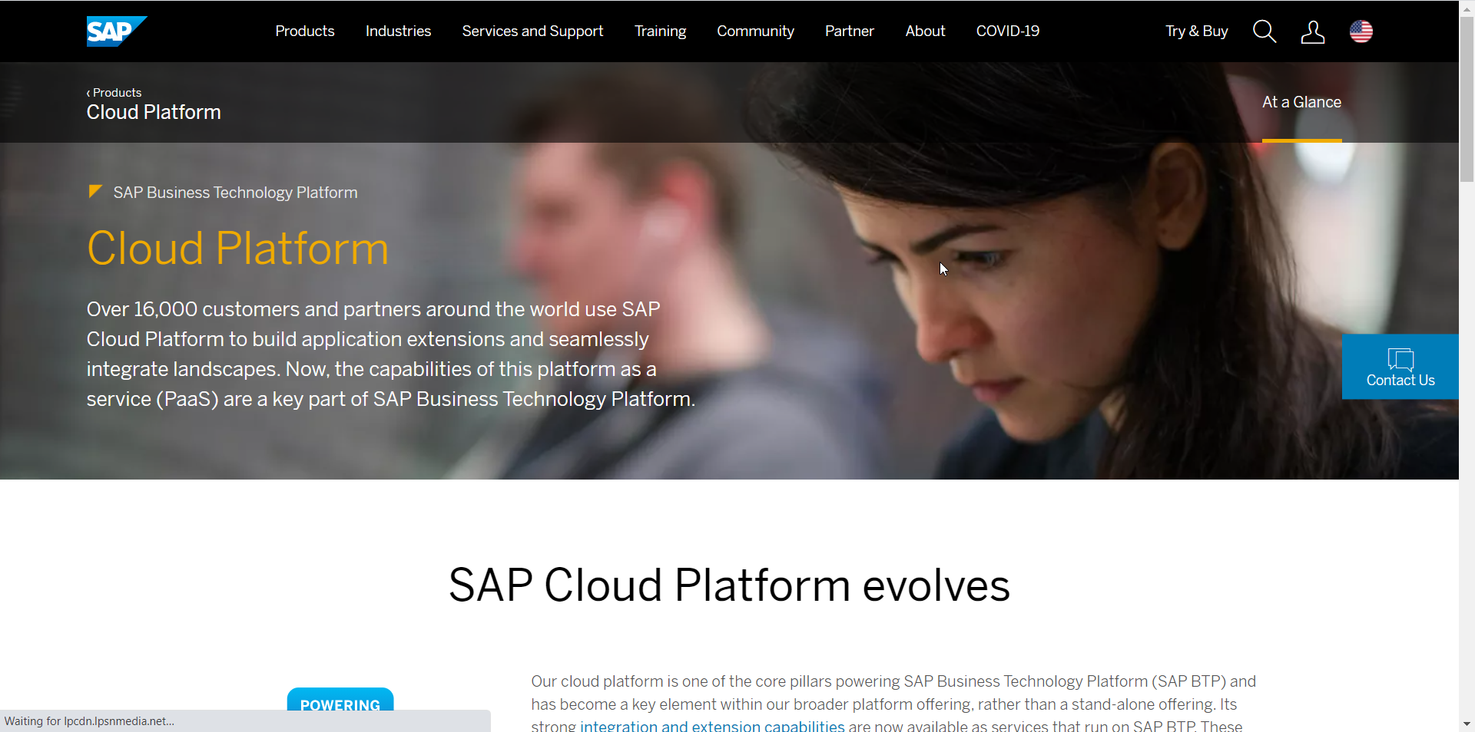
Setup Your FREE Account
https://account.hanatrial.ondemand.com/trial/#/home/trial
www.anubhavtrainings.com

Slide 22


























BTP Account Structure
Global Account
Represent a SAP customer for Billing purpose
SAP allocates Entitlements
Sub Account - FIN
US – AWS data centre
Entity Assignments
Sub Account - Marketing
IN – Azure HYD

Slide 23
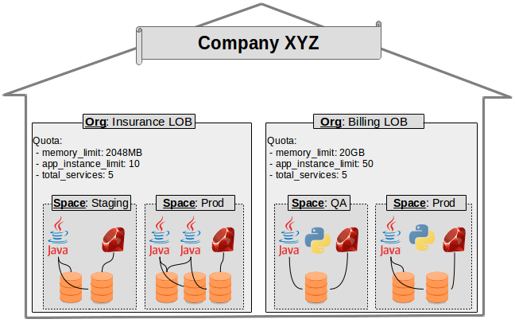
Customer View
www.anubhavtrainings.com

Slide 24
Title
Global Account – A global account represent a SAP BTP customer for billing purpose. The monthly subscription fees will be charged based on entitlements.
Sub Account – A customer can create multiple subaccounts based-on Line Of business (Fin, Co, Sales, HR, Marketing) OR teams OR projects. A sub account pertains to a Region and Data center. BTP Admin can assign the entitlements from Global a/c to subaccount.
Directory – Grouping of subaccount that will help to manage the users/developers easily for similar subaccounts.
Space – Allocation of memory where our applications are deployed. It also offers the landscape isolation e.g. dev, qlt and production. The amount of memory developer can consume in a space depends on space quota.
Limitation of memory in trial a/c – 4 GB
Next:
Types of BTP a/c for companies – real-times
BTP use cases
Tools Required for development
Introduction to JavaScript – NodeJS (NO JAVA knowledge required for this training)

Slide 25
Title
Aspect | RISE with SAP | GROW with SAP
Target Companies | Large enterprises | SMEs & startups
SAP Experience | Existing SAP users | New to SAP
Deployment | Private Cloud | Public Cloud
Customization | High | Limited
Implementation Time | Longer | Faster
Cost | Higher | Lower
Transformation Level | Full business transformation | Rapid ERP adoption
Text
https://help.sap.com/docs/btp/btp-developers-guide/basic-platform-setup

Slide 26
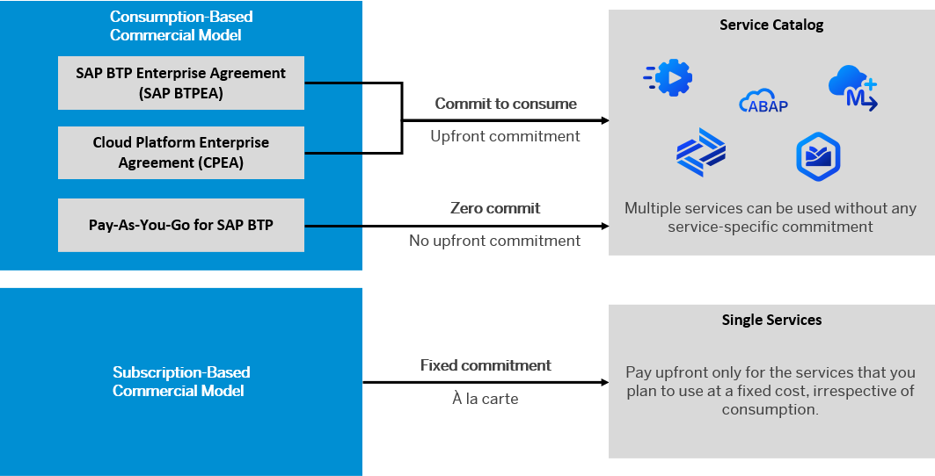
BTP Subscription Models
https://help.sap.com/docs/btp/sap-business-technology-platform

Slide 27
BTP Environments, Subscriptions, Services
Environments
Environments constitute the actual platform-as-a-service offering of SAP BTP that allows for the development and administration of business applications. Environments are anchored in SAP BTP on subaccount level.
SAP BTP offers three environments: ABAP, Cloud Foundry and Kyma. Some existing customers still have Neo, but this is no longer offered.
Subscription based services
You will also see these ones called software as a service (SaaS), or multitenant applications. The experience here is that you subscribe to the service, and in return you receive a URL, from which you can access that service. Opening the URL brings you to a web application from which you can leverage the service. This is how other SaaS like SuccessFactors or S/4HANA Cloud work as well. They are also enabled at a subaccount level and are independent of the environments.
Examples include Launchpad (new Build workzone), SAP Business Application Studio, Integration Suite, Build process automation.
Instance based services
These are the purest services. They provide a specific functionality, like databases, connectivity, authentication…. You connect your application to them to leverage that functionality. These services don’t provide a UI to manage them. Instead, they rely on API to connect to applications and other services and provide their services. They are provisioned inside an environment, so they are environment specific. Each environment has its own organization (for users and applications): In Cloud Foundry, instances are created inside a space. For Kyma, instances are created inside a namespace.
11
www.anubhavtrainings.com

Slide 28
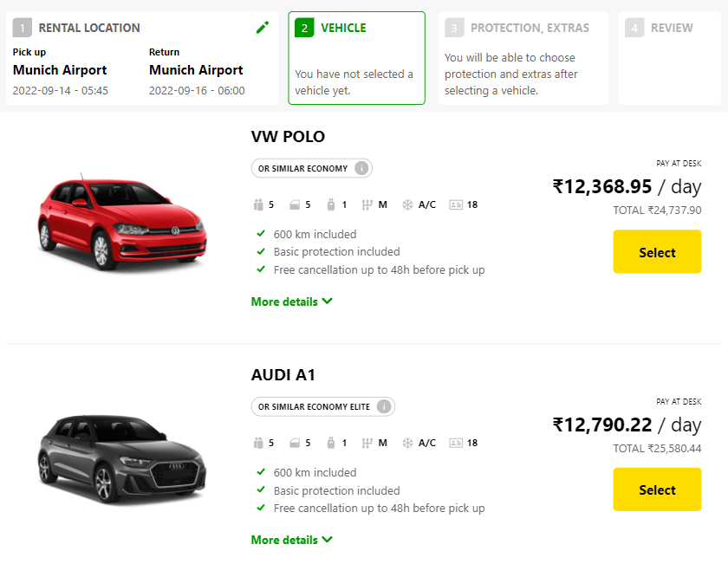
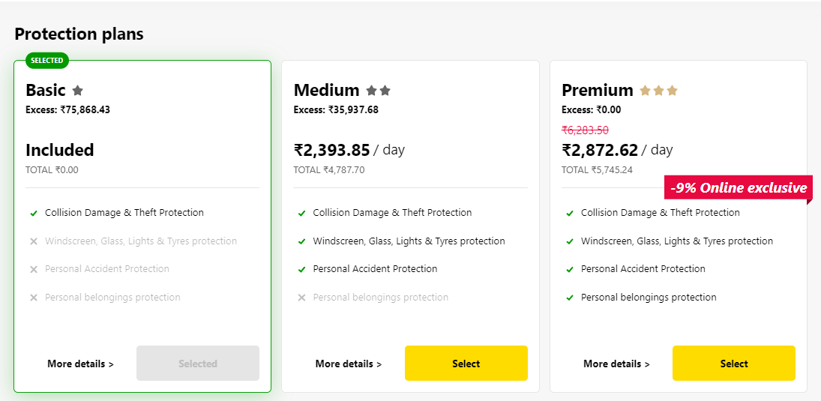
BTP Backing Services
Choose Your service
Backing Service
Select Plan
Service Plan
Each service has one or more service plans available. A service plan is the representation of the costs and benefits for a given variant of a particular service. For instance, a database may be configured with various "T-shirt sizes", each of which is a different service plan.
https://discovery-center.cloud.sap/servicessearch
11
www.anubhavtrainings.com

Slide 29


How to use instance
Car key to use Car
Service Key to Consume Service instance
Actual Car
Service Instance
11
www.anubhavtrainings.com

Slide 30
Microservice architecture
In software engineering, a microservice architecture is a pattern that organize application into multiple small-size collection of lossy coupled, fine grained services that communicate through light weight protocols. This pattern characterized by the ability to develop and deploy services in the cloud independently. Thus improving the modularity, scalability, and reusability.
Monolithic (ABAP, ABAP on Cloud) – classic abap based development where applications are build together, packaged together, deployed together. If there is a change in the application, whole app needs to be re-built and re-deployed. The scalability is hard to achieve. E.g. in SAP ECC, the systems are poorly utilized. Due to limited infrastructure and cost, the high availability setup need double the infra.
Microservice (designed for cloud apps)- The entire app is now split into small small microservices for particular function. Each service can be built, deployed and scaled independent of another. They are loosely coupled, so if one service crash, still your app will continue to work. This also brings scalability and elasticity.

Slide 31
Uber’s example of transformation
RAP
CAPM
Passenger App
Driver App
Passenger App
500GB
Driver App
300GB
Location API
Payment Gateway
Location API
150GB
Payment Gateway
50GB
1000 GB
Pax searching for CAB – 1000 pax
Actually go ahead and book – 500 pax
Actual ride arrives – 480 pax
Cashless payment – 200 pax
Pros – Choose which service need more computation resources, elasticity, scalability
Cons – Complexity increase, inter-service communication, dev effort is high, secure

Slide 32
1. Customers subscribe SAP Products using BTP
SAP BTP Consumer Account
SAP Provider Account
subscribe
S/4HANA Cloud
S/4HANA Cloud
Success Factors
SAP Analytics Cloud

Slide 33
2. Building Full Stack App*
UI and UX
services
Application logic (programming)
Database artefacts

Slide 34
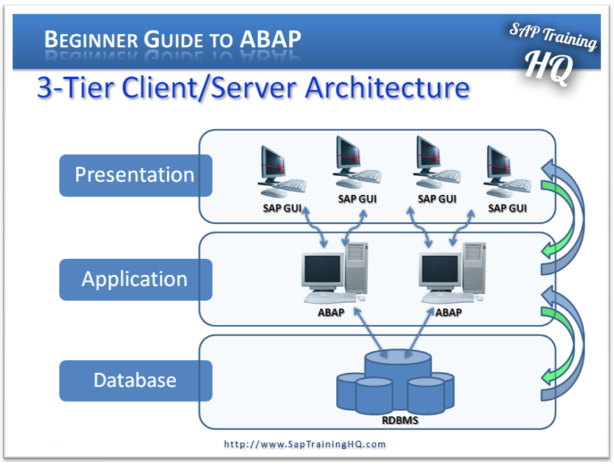
3. clean-core/ Side by Side Extension
BTP
Core
frontend
ECC
Processing logic
Read/update/manage data and logic
data

Slide 35
4. Using intelligent tech and innovations
Build Apps
BPA
Build
WZ
Joule
Studio
AI Core
AI Launchpad
Integration suite
Build
SAP BTP Gen AI HUB
BTP (foundation for new innovations and technology)

Slide 36
Tools Required for our journey
If you use your co. system, ask your IT dept. often in companies, they have a in-built software center. These are whitelisted software.
Git – Source code management system (backup, store, share, future safe) - https://git-scm.com/
Node JS – a framework runtime to execute our CAPM code. - https://nodejs.org/en/download
VS Code – A open source, FREE for lifetime Development IDE by Microsoft - https://code.visualstudio.com/
Cloud Foundry CLI (command line Interface) – When we build apps in our machine, we need to upload these apps into cloud (BTP) – this tool will help us connect to BTP account from our laptop - https://github.com/cloudfoundry/cli/wiki/V8-CLI-Installation-Guide#installers-and-compressed-binaries
POSTMAN – use to test APIs - https://www.postman.com/
Commands to cross check (may be restart laptop before check)
git -v
node -v
cf -v
cf8 -v

Slide 37
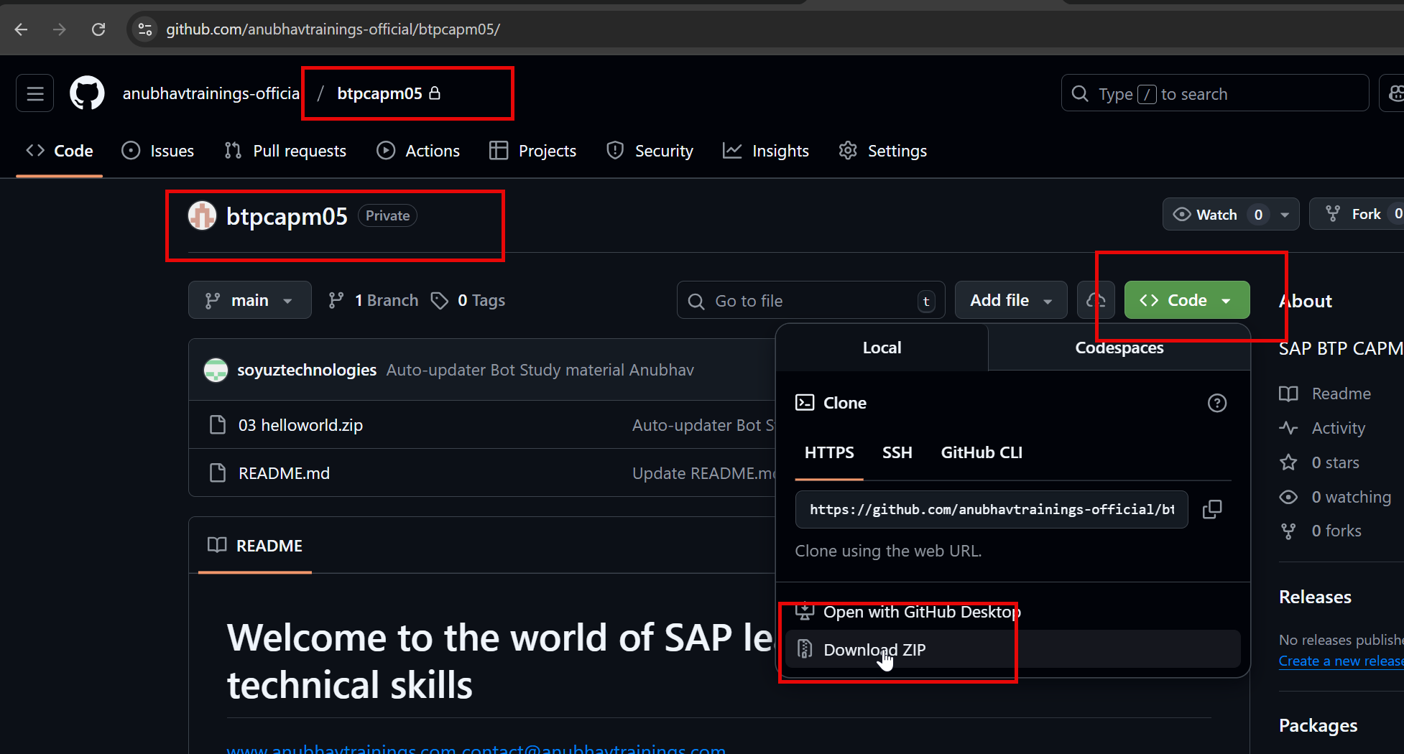
Source Code built by Anubhav
Git HUB – it is developer’s google drive ☺
https://github.com/anubhavtrainings-official/btpcapm05/
Create a a/c on https://github.com/signup?
Drop a email to mailto:contact@anubhavtrainings.com
Hello Team,
I am attending BTP CAPM training, I need access of material from git repository.
My git user name is : <your git user name>
Thank you.
6 AM – 1 AM

Slide 38
Business Application Studio (BAS)
BAS is a multi-cloud development tool provided by SAP in BTP platform. It allows us to develop, deploy and manage source code of CAPM application. You can run this tool from any device, anywhere and any platform, there is no LOCAL installation required. In trial a/c BAS is free but productive a/c it has a cost.
Dev Space – A dev space is a VM (Debian Linux) running in the cloud on top of BTP platform. It has following benefits:
It restrict the usage of cloud memory to single developer.
Dev space is a private area of developer
If a developer does something wrong, the dev space of only that developer gets affected. (Isolation)
Dev space comes with pre-configured tools, services, CLIs and frameworks for a development
In a trial a/c you can run max 2 dev space and only one can be operational at a time, 365 days limit.

Slide 39
Comparison
Comparison | BAS | VS Code
Cost | No restriction mode, you need to pay | FREE for lifetime
Plugins | CSV, other plugin pre-installed | All the plugin needs to be installed
Offline | No | Yes
Device Swich | Yes | No, There is a effort
Speed | Slow | Amazing
Code backup | Need to take backup | Need to take backup
Setup Effort | Low | High
Which company | SAP with BTP | Microsoft
License | Subscription | Open Source
OS | Linux | Any

Slide 40
Title
cf login -a api_end_point
cf buildpacks
cd helloworld
cf push
cf apps
helloworld

Slide 41
Scaling
cf scale APPNAME –i n
cf scale APPNAME -m 2G
https://cli.cloudfoundry.org/en-US/v6/
https://docs.cloudfoundry.org/devguide/deploy-apps/manifest-attributes.html

Slide 42
Client Server Architecture
GET – Read Data
POST – Create Data
PUT/PATCH – Update data
DELETE - Remove
Client
(Browser)
Header + body (optional)
Server
Request
Port
Response
Header + body
Text
XML
JSON
PDF
WORD
IMAGE
HTML

Slide 43
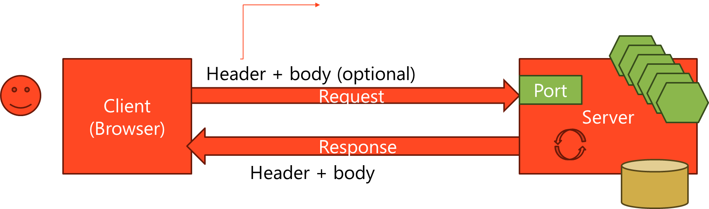
Node JS
Node JS is a framework which provide runtime environment for Java Script language. Java Script and Java are completely different languages in their design, approach, purpose and usage.

Slide 44
Node JS
Node JS is an open source framework, which provides runtime environment for Java Script Apps. It can be installed on any platform, open source, free, very good to design data intensive apps. As a developer you can learn Java Script which is enough to become a full stack developer.
Java Script
Java and Java Script are completely different languages in their nature, purpose and use case. You don’t need to learn Java at all for learning JS. JS is a lightweight programming language which is free. It is easy to learn, it is different from other languages as it’s a Asynchronous Non Blocking IO.
It can be used :
Create front end apps
Build business logic
DB lookups
Send emails
Prepare PDF, EXCEL…
Write processing logic
Make call to web service
Design your own web app and services

Slide 45
Funda fox:
Java Script unlike ABAP is a case-sensitive programming language e.g. Anubhav & anubhav is difference
Each statement ends with semi-column ; (ABAP it ends with period .)
We follow camel case naming convention in JS, first letter of every word is small, next consecutive word’s first letter is capital – iloveindia 🡺 iLoveIndia wearelearningJS 🡺 weAreLearningJS
When we use standard functions, create our own variables and functions, we use camel case e.g. indexOf
When we create variable a NULL is assigned to it, any operation we do with NULL become a NaN
To create variables we use var or let keywords. We can create constants using const
To print the output in terminal we use console.log()
When we create variable in JS, the data type is automatically decided by the value we assign
There is also an advance version of JS called as Type Script, there we need to put variable types.
In JS, = is a assignment operator and == and === are comparison operators, == compare data, === compare data and data type.
Double quote and single quote works same in JS like to define a string data
Tilted quote will be used to combine string and variables with ${var}

Slide 46
Variables
Scalar Variable
Arrays
Java Script Object Notation = JSON
Array stores multiple values of mostly same data type
Use bracket symbol to create array [ ]
Each element inside array is referred using index, index starts with 0
We can also loop over an array
They contain data of different types
Light weight data format in JS
Typically represent a key value pair using curly braces { }
Syntax :
{
key: value,
key: value,
key: value
}
You can validate json with https://jsonlint.com
Hold single value at a time
Assigning new value replace old one
( ) – parenthesis
{ } – curly braces
[ ] – brackets

Slide 47
Functions in JS
Block of code for reuse purpose, so you can call it again and again.
Anonymous function
Named Function
A function that does not have a name, we use them to pass a function inside the argument of another function.
function (p1, p2…) {
}
Reusable functions that can be called again and again.
function functionName(p1,p2…){
}
https://www.w3schools.com/js/

Slide 48
Module in Node js
A reusable JS file which is either created by ourself (util/reuse.js) OR a standard module provided by node js , automatically installed along with it. E.g.util, fs, events etc.

Slide 49
Asynchronous Non Blocking IO
Facebook
(browser)
Server
Synchronous – User is blocked
ABAP, Java, Python
ASynchronous –
Non Blocking IO
Callback function
Promise

Slide 50
Promises in JS
Promises are like real life promise
A promise is fulfilled – resolve – HANDLER - then
A promise is rejected – reject – HANDLER – catch
Promise offers additional capability to allow developers to run both sync and async
Whatever your asyc logic is, you need tie it with a promise
Create a wrapper function over the promise – can be called both sync (async…await) or asyc
Create your mail logic code to call the promised function

Slide 51
How to start a real time node app
Create a project folder and run a command called npm init it will initialize our node project by asking questions like name, version, license, author, purpose, dependencies
System will create a file called package.json which will contain all the details of our node application
NPM – Node Package Manager – is like a hotel manager which takes of all the dependencies for us related to the project. When we build a software, we are living in 21st century, the time is gone when you write every piece of code yourself. It’s a time when all kinds of code is already built by people, you just need to find the right code, use it, plug it and develop on top of it. DO NOT REINVET the WHEEL.
We have so many powerful frameworks, modules, reusable libraries which we can consume and build our app. E.g. there are modules for sending email, triggering whatsapp, doing database lookups, creating pdf. It is worlds most powerful open source eco system – https://npmjs.com
To reuse any of the module, there are 2 ways
Using module inside your project – npm install <ModuleName>
Using module @ computer level (tools and cli) – npm install -g <ModuleName>
When we install a module, the module dependency is automatically added to the package.json file, so the developer will know that, this project is built using what are the modules in future.

Slide 52
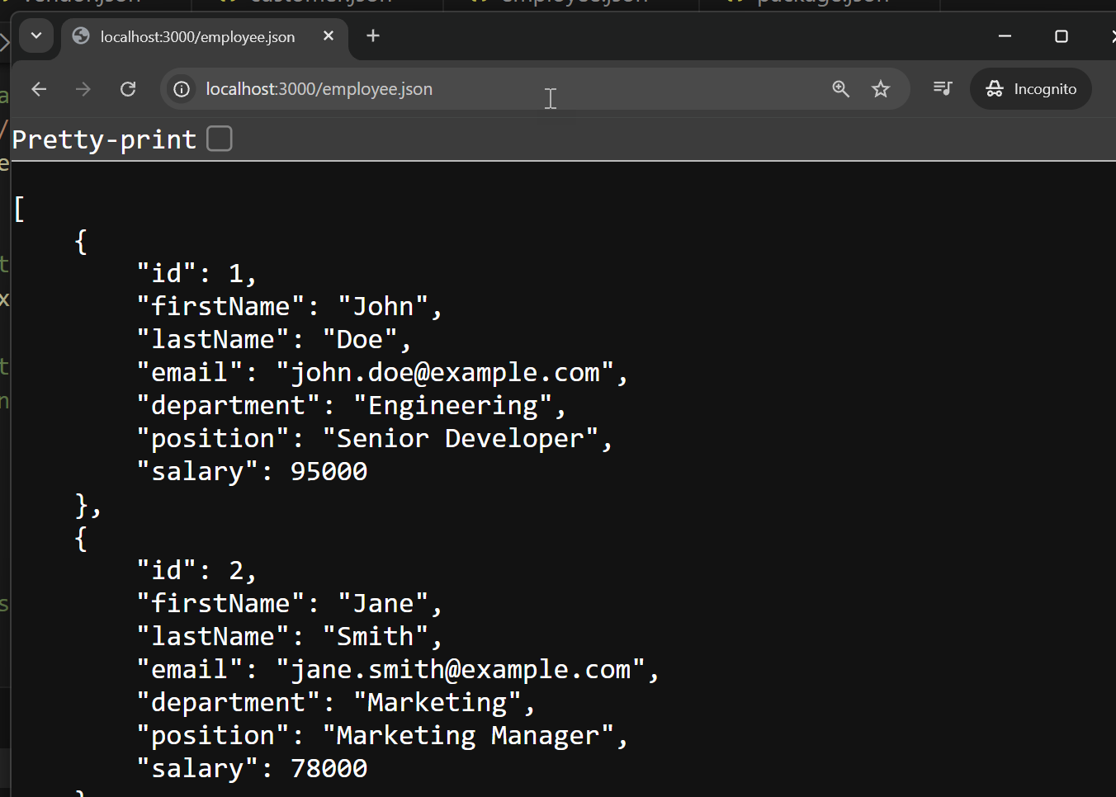
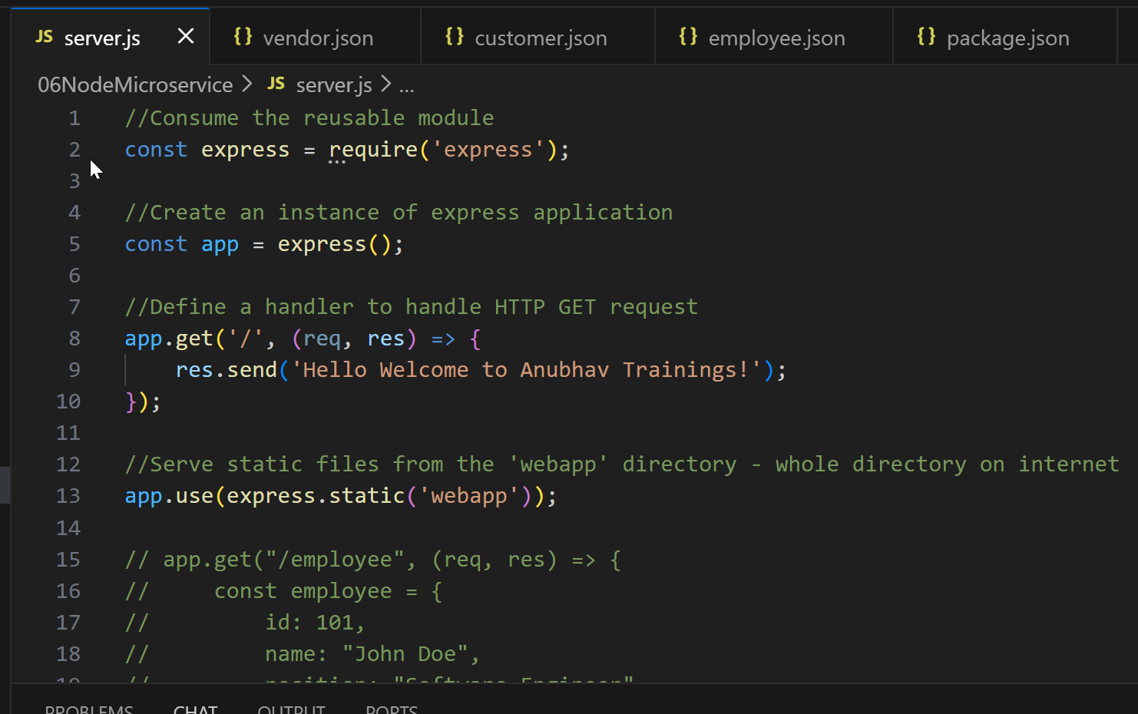
Title
Text

Slide 53
Challenges to Build BTP apps using NodeJS
The coding effort is very high, we are living in 21st Century, it is not the time where we write every single line of code ourself manually. This new world is filled with powerful frameworks which let the developer offload common tasks and code. They provide libraries, classes, modules to avoid writing code and build by reuse.
Anubhav my company recently opt for Rise with SAP (with comes with BTP subscription), everyone in the team is confused on what is the methodology & framework to use building SaaS apps.
Are there any recommendation from SAP to design, build SAP application on BTP as a gold standard/best practice?
When we create NodeJS app, we also have to take care of all the dependencies.
As a developer you want to focus more on business logic and less on boiler plate code and small-small parts of application components.
There is no Reusability and lack of standard practice, will lead to conflicts and time to handover.
Most apps are tightly coupled with database, so when database change, your code also get impacted. Depenency on SQL which is what will hamper future innovations.
No matter which area you come from MM, SD, PP, APO, WM, EWM, MDG, SRM, HR, we all do same work
The maintenance of the source code is also very high
Use Framework:
SAP RAP (Restful Application Programming Model) – ABAP technology, monolithic architecture, SAP ABAP Platform for BTP, SAP ABAP CDS knowledge
SAP CAP (Cloud Application Programming Model) – Open Source Technologies, Microservice architecture, CF environment, NodeJS
https://www.youtube.com/watch?v=n0oS1eiOWU0

Slide 54
CAPM
CAPM is a framework – a collection of libraries (reusable - Modules) – include classes, methods, attributes, events etc., tools, languages to help development teams to quickly create SaaS on BTP with open source technology.
Language – Node JS and Java
Libraries (Modules) - @sap/cds, @sap/cds-dk
Tools – VS Code, BAS
https://cap.cloud.sap/docs/
CDS – Core Data and Service
Conceptually CDS is same concept but different flavor. The concept says that we will have a design time object (which is what developer code .cds file). For anything we will create the cds file (DB, SRV, UI) and this design time object is compiled by the framework (@sap/cds). After compilation, it creates a Runtime object.
Runtime object
Project
Compiled @sap/cds
.cds

Slide 55
@sap/cds-dk
DK – Development kit
It is a node module which is part of CAPM framework and should be installed globally in system to provide us the CDS command line interface. If you are using BAS tool, it is already installed and configured.
It offers the CLI which will help to design and develop cap application quickly. It helps building cap projects, testing, delivery, packaging, deploying.
npm install -g @sap/cds-dk
cds -v
If you using your company laptop and you don’t have permission to install anything, Use BAS tool for this training.

Slide 56
Aspect in CAPM
Aspect are the reusable types (like structures in abap) which help developers to add the reusable components in our entities. These aspects can be custom (we can create) or standard (provided by @sap/cds/common). It will help reusing things like Currency, Country, CUID etc.
https://www.w3schools.com/jsref/jsref_obj_regexp.asp

Slide 57
CDS Views?
If you worked in ABAP CDS views, its conceptually same but a different flavor. Why we create views in a software development:
Often our data is distributed across multiple data base table, we need to retrieve data by joining it again and again, for which we write COMPLEX SQL logic every time, which is a tedious task.
Views also bring down the effort of extracting data from system
View is a contract of data which is well defined
We can also apply on-fly calculations w/o contaminating the original data like CASE, AGGREGATION, UNIONS
View also provide security of the data, we can create projection
They can offer alias names e.g. my table has a field called MATNR, alias MaterialNo
We can apply constraints on the level of views
CDS views are the ultimate contract for data in SAP. We can also use lose coupling concept called mixin in the cap cds views which allows lazy loading of data.

Slide 58
Disadvantage of Node JS App
Node JS apps require lots of setup, every developer have to do this setup again and again
When we build microservices, it needs lots of exploration and boiler plate coding to get a simple service
Companies started using BTP, they realized that every developer was coding node apps in their own way, some using express, some using axios etc. this leads to confusion, conflict. What is the best practice?
Lack of standard leads to poor code quality
The time it takes to handover the code is very high
There is no guideline provided by SAP to design and develop cloud apps which will be future proof
The possibility for integration with SAP application leads to lots of coding effort
Latest innovations are hard to adapt, adding application security involve lots of steps and pain
What is the best practice/gold standard to build SAP BTP Applications and Services?
When a protocol goes of upgrade like ODATA 2.0 🡺 4.0 how fast I can adapt, do I need to code more?
Using CAPM to build services

Slide 59
What is OData
Open Data protocol to create web service provided by Microsoft and it’s a open source which is adapted by SAP to create services. All the consumers will adhere to the rules of this protocol to consume services on internet(cloud). The consumers could be ABAP, Java, Web, Android, Fiori, Analytics, Integration tools.
OData service provide abstraction from underlaying technology and database. So in future e.g. if you rebuild cap application by Java or change DB to HANA from SQLITE, it does not affect the consumer applications.
By Default, CAPM application services offer OData protocol version 4.
The best part of CAPM is to provide a fully ready implementation of CURDQ (Create, Update, Read, Delete and Query data).

Slide 60
Title
Text
https://docs.oasis-open.org/odata/odata/v4.01/odata-v4.01-part2-url-conventions.html

Slide 61
How to kill the port which is closed
Linux commands
lsof –i :PORT 🡪 lsof –i :4004
kill -9 PID 🡪 whatever you get as process id from last command
Deep Insert
In the Odata services, the deep insert is used to perform Create (POST) operations on both parent and child entities together. Usually when we create sap applications we have parent-child relationships like OrderHeader-OrderItem, GL-GLEntries, PurchaseOrder-Items, PersonnelNo-SalaryEntries, SKUs-BoMs. With the help of Deep insert, we can create both the data together to ensure transactional consistency. In CAPM you don’t need to write extra code for that unlike ABAP where we implement CREATE_DEEP_ENTITY method in DPC_EXT class. Make sure that both entities are in Composition Relationship. While creating it's not mandatory to pass PK of parent data in child data.

Slide 62
Association v/s Composition
Association
Lose coupling between entities
Both entities can function independently
Should have relation – good to have
Composition
Tight coupling between entities
Creation of child entity not possible w/o parent
Must have relation

Slide 63
Generic Handler
As we experience that the CAP framework generated most of the CRUDQ code for us behind the scene, Sometimes as a developer you would like to add extra code, extra functionality on top of it, in that case we can use Generic Handlers. The Generic Handlers are special functions which we need to define and implement at appropriate points (exit points provided by SAP). These are used for various purpose
Adding custom validation e.g. how to validate a low stock product while creating POST on purchase order, check employee salary based on custom validation in our company.
Provide additional logging and tracking
Enhance the data on top of the data which is read from database (virtual elements)
When?? – before, after, on
Which Entity?? – The entity of your odata like PurchaseOrder, Employee etc.
What Operation?? – READ, CREATE, UPDATE, DELETE, *
this.WHEN( [ Operations ] , WHICH , (req,res) => {
});
Example – Validate salary of employee while creating or updating employee data.

Slide 64
Sequence Diagram
Fiori App
OData
CAPM
OwnCode
Database
Key input
<data>
<data>
<data>
req.data

Slide 65
Debug Config
{
// Use IntelliSense to learn about possible attributes.
// Hover to view descriptions of existing attributes.
// For more information, visit: https://go.microsoft.com/fwlink/?linkid=830387
"version": "0.2.0",
"configurations": [
{
"type": "node-terminal",
"request": "launch",
"name": "Anubhav Trainings CAP Course",
"skipFiles": [
"<node_internals>/**"
],
"command" : "cds watch",
"cwd": "${workspaceFolder}/mycapapp"
}
]
}
Debug | ABAP | CAP NodejS
Step over | F6 | F10
Step In | F5 | F11
Step Out | F7 | Shift+F11
Continue | F8 | F5

Slide 66
Functions and Actions
Functions and Actions are non-standard operations in CAPM. Unlike the standard CRUD, they serve special purpose to run domain specific operations. These can be instance-bound or Non instance-bound (connected to an entity). If they are instance bound, the entity KEY will be passed automatically as a input to these handlers.
Functions – like function import in abap odata service. They are side-effect free operations because they are just used to GET the data. They always return data in output either one entity instance (one record) or multiple entity instances (multiple records). E.g. write some logic to get top 3 most expensive purchase order.
Actions – Called by POST calls, they can cause side-effect because they have ability to modify, create new data in the database. E.g. implement a boost functionality to boost a purchase order value by 20000.
CDS QL – CDS Query Language
Often the function and actions implementation is done with the help of cql which is a DB agnostic language to produce calls to database. We as a developer interact with database using Type-safe APIs, by not writing direct SQL to db. It offers APIs like SELECT, UPDATE, tx, CREATE to perform various database operations for customized implementation.
https://cap.cloud.sap/docs/node.js/cds-ql#select
General Thumb Rule – Define, Implement, Test

Slide 67
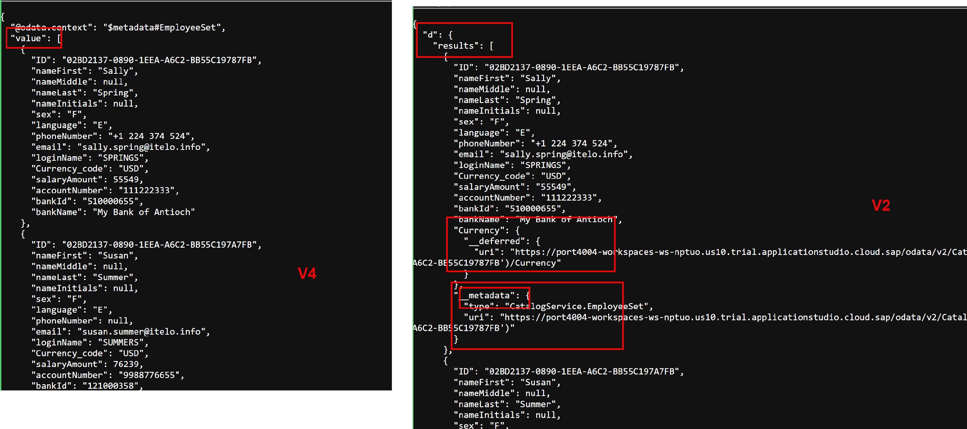
V2 v/s V4
Notes:
@cap-js-community/odata-v2-adapter

Slide 68
Virtual Elements
These are the fields which are added and computed in services at runtime, and they do not persists in the database. Sometimes in business applications we need to do computations at runtime, however we don’t want the data to be stored in the database. E.g. I want to show total cost of an order by multiplying amount X quantity.
When we want to calculate something based on formulas @ runtime.
Use Case: We have products data coming from CDS View, my manager asked me to also show with every product a count. The count will tell us, how many times that product was ordered.

Slide 69
Title
SELECT ProductId, count(ProductId) as anubhav FROM ItemSet
GROUP BY ProductId
WHERE ProductID IN […..]

Slide 70
Fiori Element
Fiori Elements is a farmwork to design and develop Fiori apps. You don’t need to learn coding of JS, HTML, CSS etc. The framework offers pre-defined templates to create end to end applications which are responsive. The UI Code is generated by SAP out-of-box.
List Report Template – Fully transactional app
Overview page
Analytic List Page
Worklist App

Slide 71
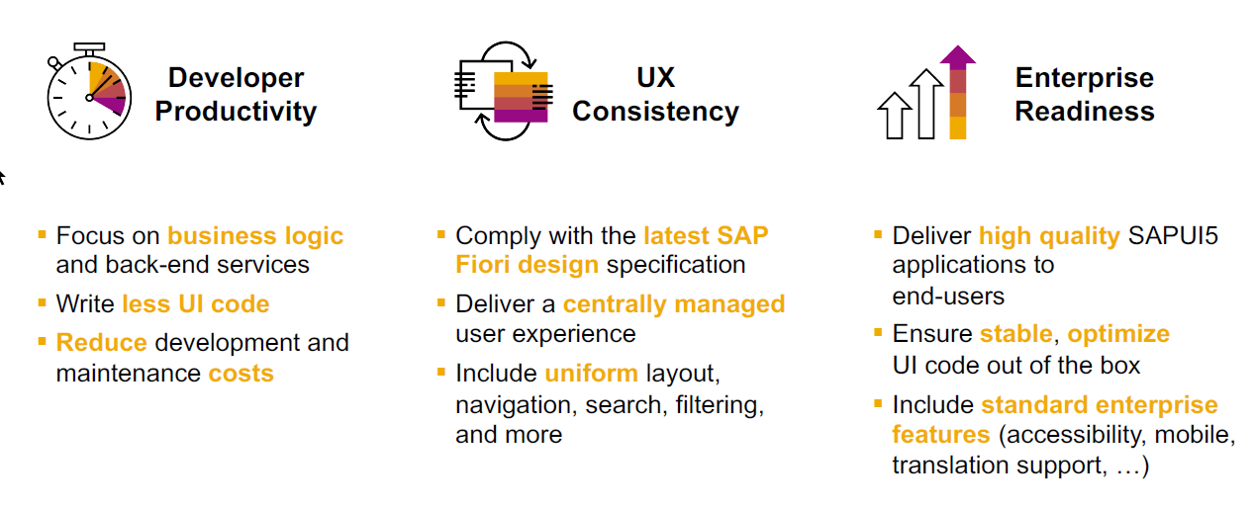
Fiori Elements – Key benefits
11
www.anubhavtrainings.com

Slide 72
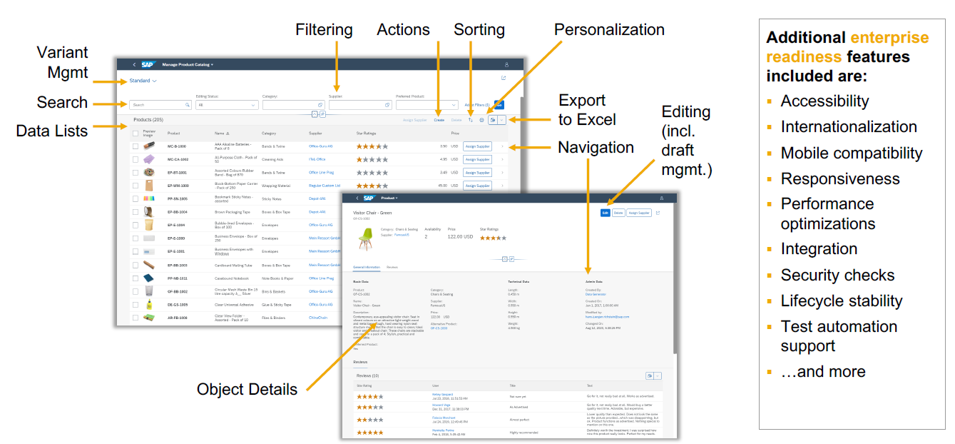
Features
11
www.anubhavtrainings.com

Slide 73
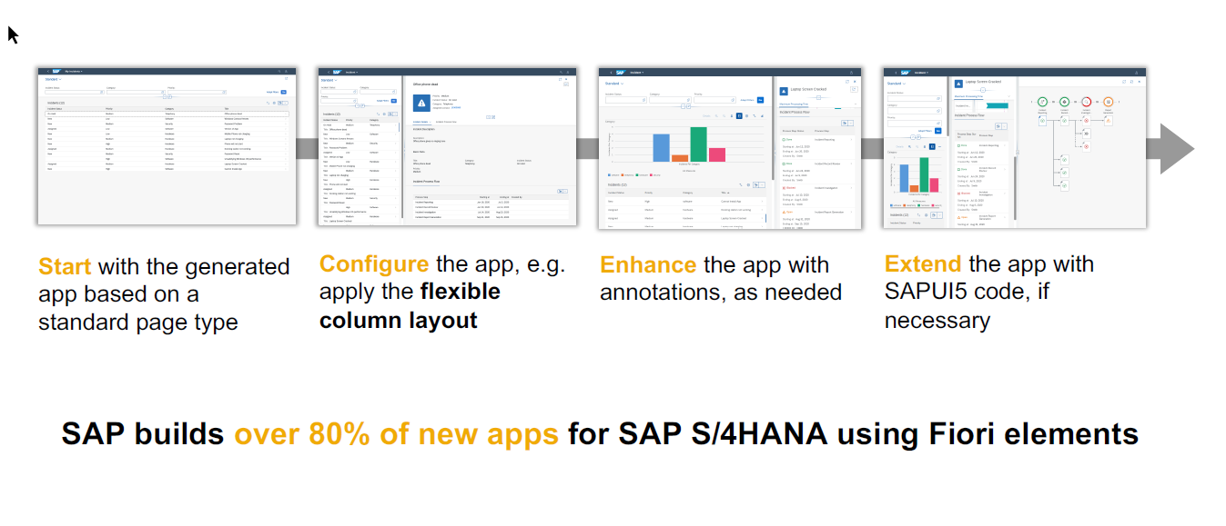
Steps to be followed
11
www.anubhavtrainings.com

Slide 74
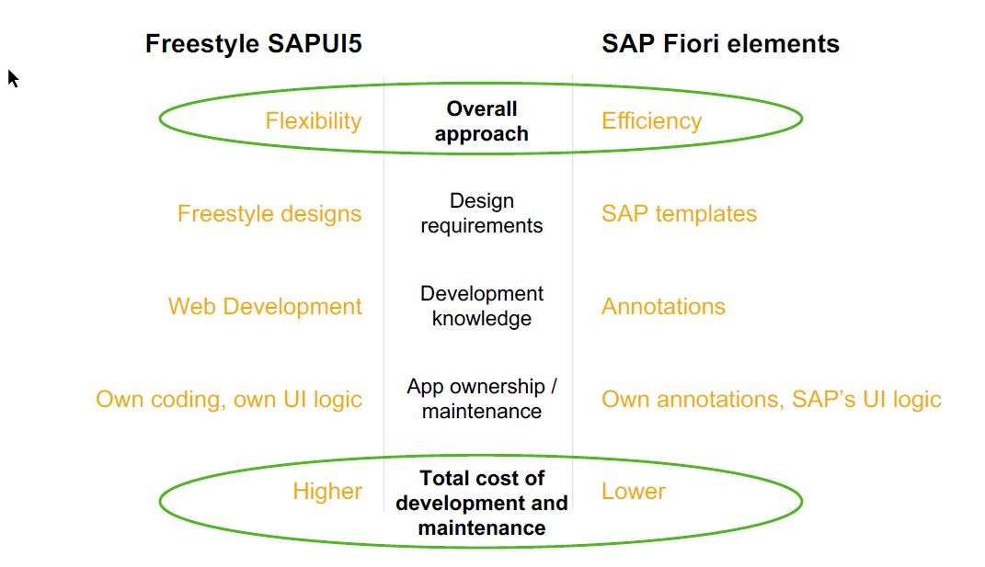
Fiori Elements v/s Freestyle Apps
11
www.anubhavtrainings.com

Slide 75
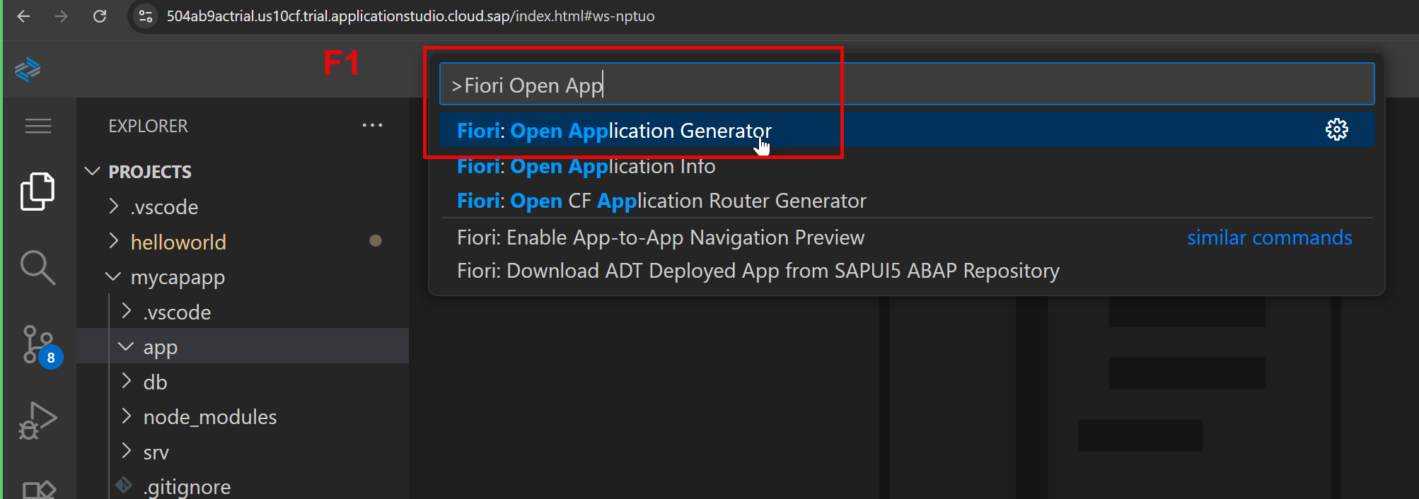
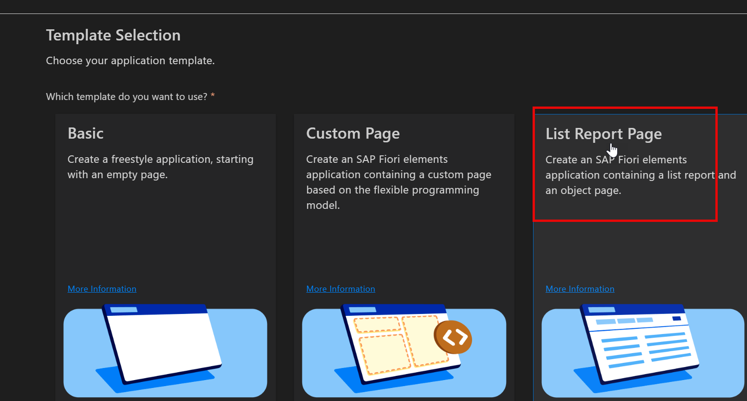

Slide 76
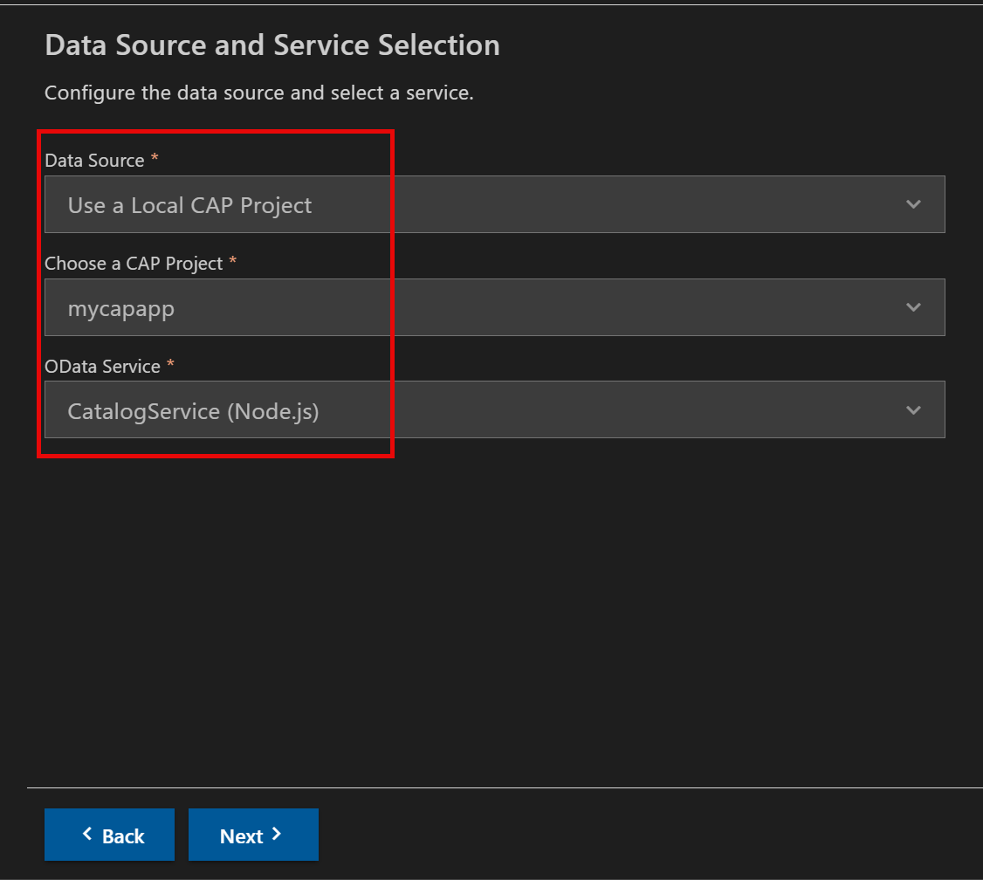
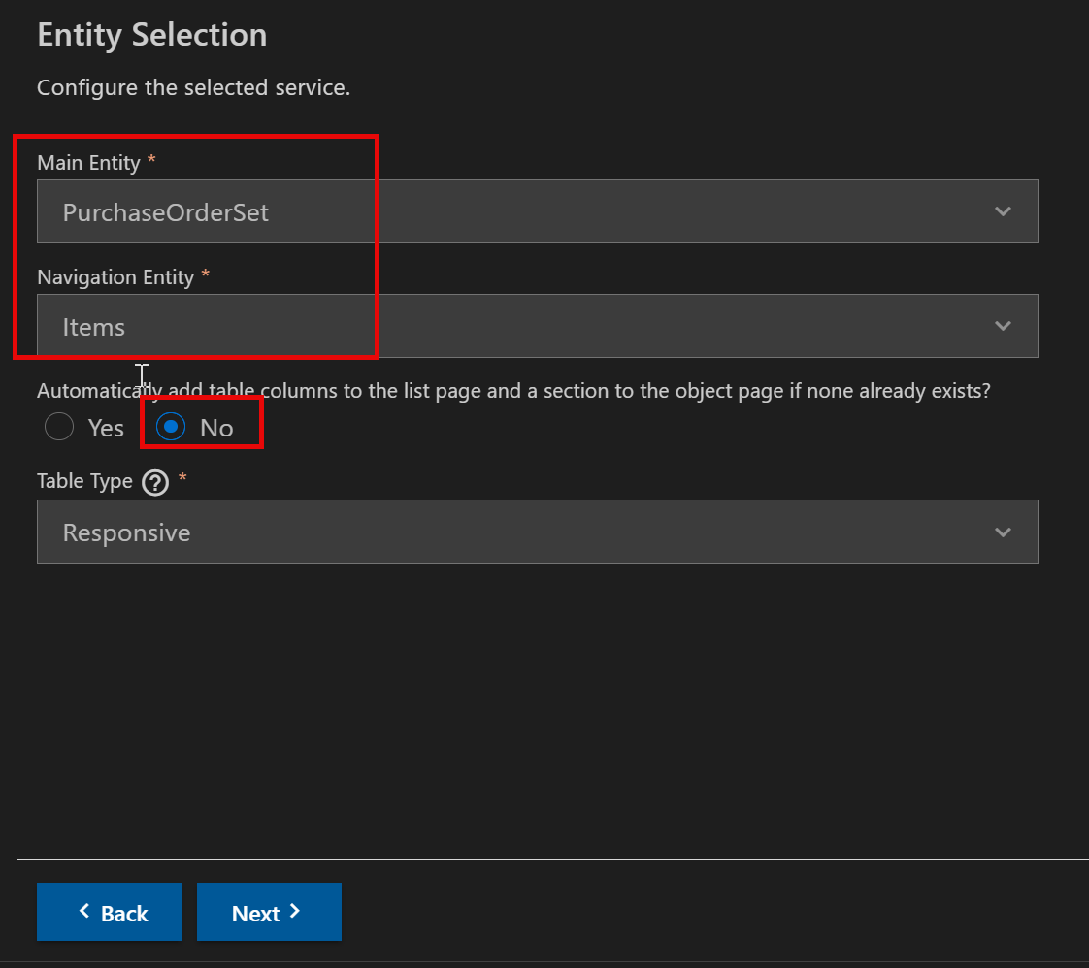

Slide 77
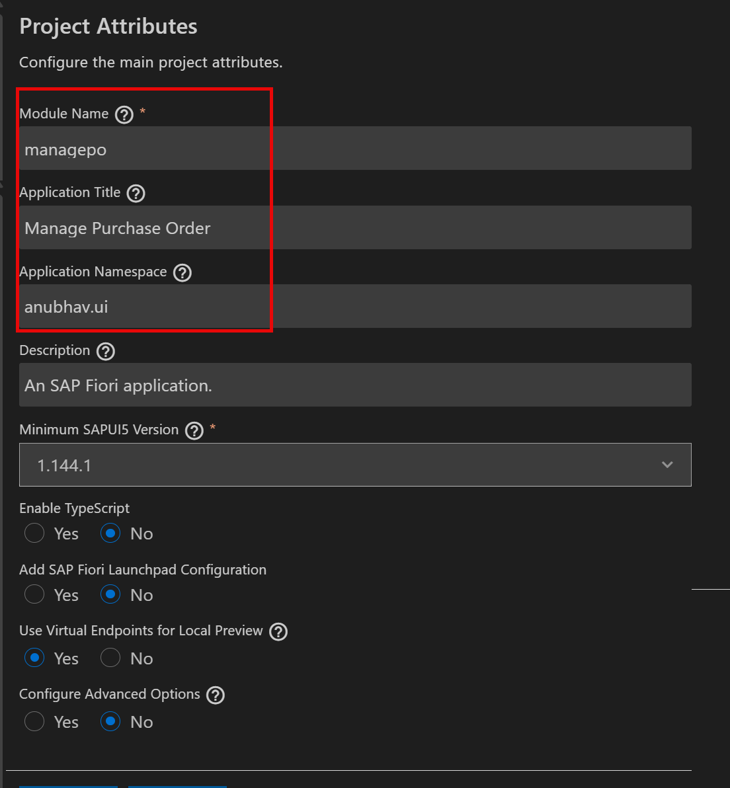
https://ui5.sap.com/#/topic/993e99eae4414b73bc7afef9518c79bf

Slide 78
Annotations Summary
@UI.SelectionField – to add filter fields in the filter bar
@UI.LineItem – to add columns to the table
@UI.HeaderInfo – to add title of table and header title for 2nd (object page) screen
@UI.Facets – to add tabs
UI.Collection – to add a big block of smaller blocks inside
UI.ReferenceFacent – to refer blocks
@UI.Identification – to create a default (one) to create fields
@UI.FieldGroup – to add multiple group of fields, multiple blocks are allowed
In order to make the labels available in different languages, we use concept of internationalization 🡺 i18n
https://port4004-workspaces-ws-nptuo.us10.trial.applicationstudio.cloud.sap/anubhav.ui.managepo/index.html?sap-ui-language=de

Slide 79
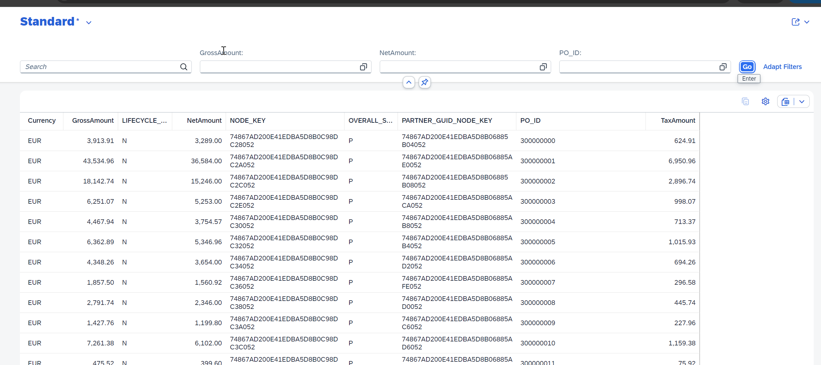
Selection Fields and Line Items
<content>
@UI.selectionField
@UI.LineItem
11
www.anubhavtrainings.com

Slide 80
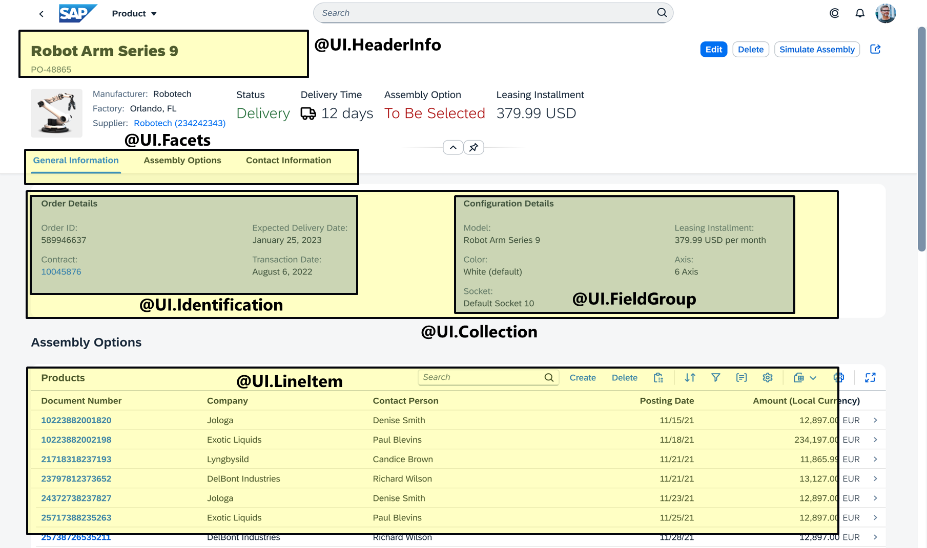
Object Page
<content>
11
www.anubhavtrainings.com

Slide 81
Database in Cloud
So far in our CAP application we are using a local file-based database called SQLite, which is suitable for local development as long as we create app in vs code and bas tool. Once our app is fully ready, we will be deploying our app to cloud, and in the cloud for production scenario, we need a cloud-based database.
There are 2 options in BTP for the same
Postgres SQL – open-source database which is based on traditional RDBMS. Traditional databases stores data in HDD, they are relatively slow however they are cheaper. If you design simple cloud apps with simple analytics and CRUD scenarios (full stack apps with CAP), number of records are in millions.
HANA Cloud database – SAP’s proprietary database introduced in 2013. it evolved over the time and now available as DaaS service. It a in-memory database keeping data in RAM, multi-core CPU architecture, compression, data organization, column/object store, build agg. On fly, good for performance. If we want to create data-intensive applications on BTP which requires Billions of records to process on-fly. It is costly as compared to Postgres. Also offers capability of data lakes, vector engine, KGE.
Difference between Data lakes, Database and Data warehouse
https://www.youtube.com/watch?v=BlnTn7Ewifs
Use Postgres and HANA Cloud together with hybrid configuration
https://www.youtube.com/watch?v=zZckRSi9Sy8
https://www.youtube.com/watch?v=lnPhJRxZPwQ
Can you also show one more complex data model on CAP
https://www.youtube.com/watch?v=5Ak-AO_xFbw
Can I use Mongo DB with BTP CAPM, finally run app not on BTP rather on AWS – framework is CAP
https://www.youtube.com/watch?v=zXZf8kKM9NA&list=PLcxqFaocb9WLaza2kOjkUCDIQGbzNos6p&index=47

Slide 82
Title
Text
{ "data": { "memory": 16, "systempassword": "Welcome1", "edition": "cloud", "whitelistIPs": [ "0.0.0.0/0" ] }}
In SAP BTP Trial Account SAP will stop the database instance everyday 11.30 AM India time. So if you have a CAP application running on top of it, you should make sure that DB is running during that time else you have to restart the DB instance using HANA Cloud tools.

Slide 83
Schema?
Schema is a mandatory database object which exist in every database in the world. It contains all the runtime objects of database (like tables, views, sequences, triggers, structures). The benefit is that it provides the grouping, separation of concerns and security to our database content. It also makes our database used by several systems together.
Cons:
It is created manually by a database consultant (Human), All the permissions are with the human and if the human leaves the company they need to transfer the permission to someone else. = ownership
A schema cannot be created in cloud because it does not use microservice.
Solution
HDI Containers
HANA Deployment
Infrastructure

Slide 84
HDI Container and HDI Service
A HDI container is just like a schema, it contains all the runtime objects. It is not created or managed by Humans.
Who manages it?
It is managed by application, as long as you have application code protected with you (github), you still have access to the HDI container. Even a developer leaves the job, the access is still with whole team.
How will application talk to HDI container?
Application will use a BTP backing service called HDI microservice to talk to the HANA DB and manage the HDI container. Since the HDI container is managed by service, we can use them in cloud.
Two aspects for HDI Container when you build CAP app
Design time – when developers are building app and testing locally (developers should separate data) – each developer when they connect to DB, will work with their private HDI Containers.
Run time – when app is used by production users finally (users should share data)

Slide 85



Design time
HDB
mycapapp
cds deploy --to hana:mickey
cds deploy --to hana:donald

Slide 86
Make your app run on HANA connected to BAS tool
We need to connect to our BTP a/c from BAS/VS Code to let computer know where we have HDB – cf login
We need to add dependency on HANA module that manage the HDI service in BTP - cds add hana
Install the dependency added (@cap-js/hana) – npm install
CAP needs to convert the .cds file to HANA specific format (.hdbtable etc) – cds build --production
[Extra], please download the hanacsv.zip file provided by Anubhav to replace all csv’s in data folder.
Lets deploy container to DB – cds deploy --to hana:mickey
Once done system will create a file .cdsrc-private.json it contains our BTP microservice connection details with our project so later when you restart BAS the project still knows which container its connected to. It creates a configuration which has the details of connected services and keys to use.
To run our app connected with HANA DB configuration (name: hybrid) we need to run command
cds watch --profile hybrid
Open HANA Cloud tools to start stop instance
Open HANA Database Explorer tool – DBAMIN / Welcome1

Slide 87
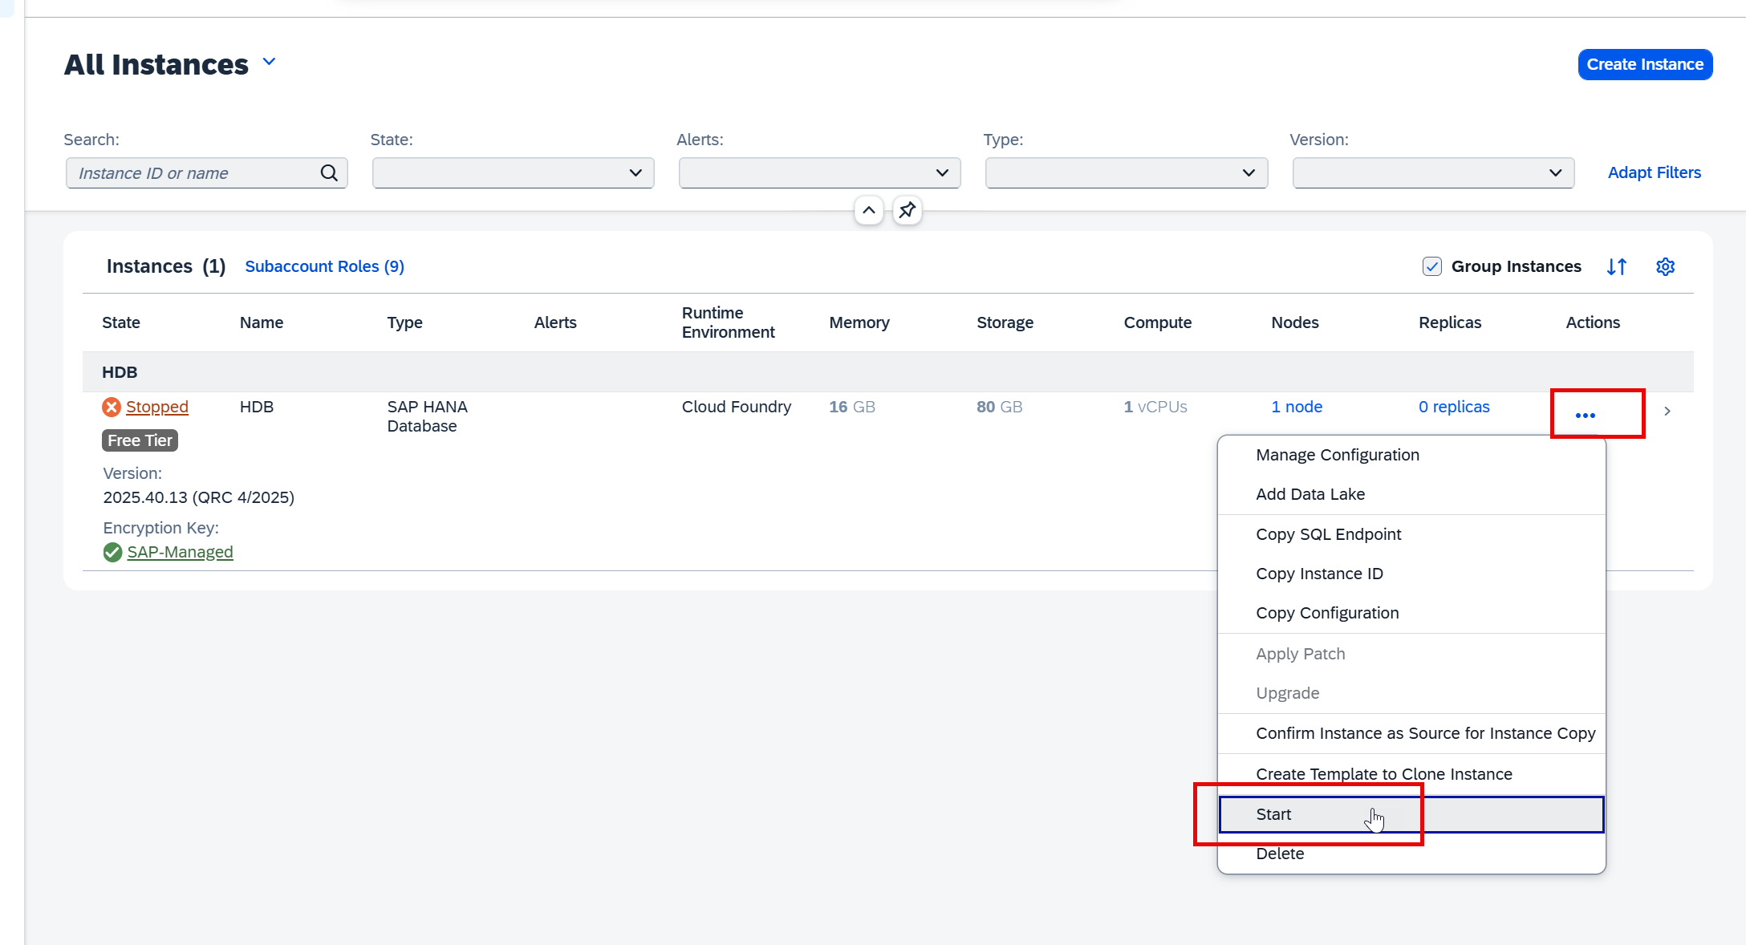
Reminder: Start HANA DB
Text

Slide 88

Authentication & Authorization
Authentication – is a process in which application security is checked by ensuring a valid user is coming to our app. Does he/she come to our app are a valid application user in the company. It is enforced using a login screen. The login screen can be a standard login screen offered by SAP or a custom login screen of our company. Usually the login screens are managed by special software called IDP (Identity Provider). This IDP is registered by our BTP account in the trust section.
Authorization – Once the user is authenticated, the authorization comes into play. It ensures a logged on user have specific permissions to perform particular activities in our application (like Create, Update, Delete, Approve, Reject). This is often configured using Roles in SAP. In case of BTP we use modular approach – Scopes, Role Templates and Role Collections. As a application developer, it is your responsibility to define these for your app.
In case of SAP BTP, there are 2 major components which controls the overall security
IDP – Identity Provider
XSUAA – XS – eXtended Services, UAA – User Account and Authorization

Slide 89

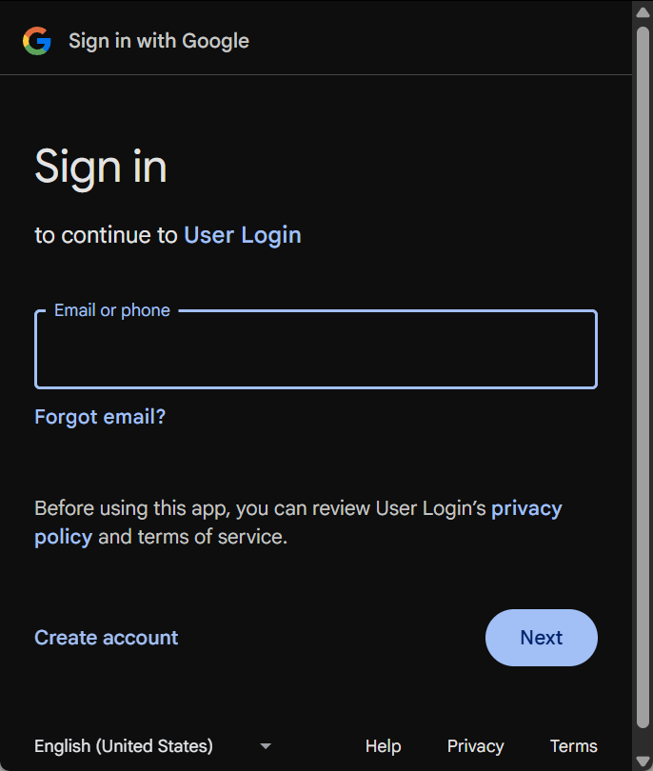

IDP – Identity Provider
It ensures the login mechanism for our users. It offers the LOGON screen for users coming to connect to our app.
Centrally stores all the users, credentials and authority (clerk, manager, ceo, cio)
When a user leaves the company, the admin just need to delete/block user from IDP
It simplifies the login process for the user and user don’t need to remember many passwords
Single source of truth for all the users/credentials and permissions and scopes
Companies often buy IDP and configure it with their own branding and login screen
E.g. SSO, Google IDP, Linkedin, Meta IDP, X IDP, Active Directory, SAP also provide a IDP software as a service called CIS (Cloud Identity Service)
SAP systems
Fiori launchpad
CO. Portal
SSO
(idp)
SRM
Single Source of truth about users, Roles, passwords centrally
Outlook
mycapapp

Slide 90
XSUAA – Security guard of BTP a/c
As a developer we don’t want to interact or learn various IDPs and their protocols, to ensure security of our BTP application SAP introduced a standard component called XSUAA in cloud foundry. This is built-in
It offers below:
XSUAA is the middle component between our Application and IDP, by ensuring a trust relation with IDP
It will redirect our user to IDP when he/she tries to access our app and not authenticated
It validates the token which user get from the IDP (SAML – Security Assertion Markup Language)
It ensure secure access to all our BTP applications
It manages also authorization (application security), As a application developer we need to inform prior to the XSUAA, what roles and permissions will be required inside our app
As a developer we will create a special file called xs-security.json file in root directory of our cap project
In this file you maintain Scope, Attributes, Role Collections, Special configuration
We must follow the SAP guideline to define the file as here
In case your are confused, what roles to define, what scopes, usually you can create basic scope and role collections like Viewer (who have view permission) and Admin (who have Write/Delete access of data)
Additionally, we can control ROW level permissions and security of our data
Accepts the SAML token from IDP and verifies it. Issues a JWT (JSON Web Token) to the user/application user is trying to access by injecting the Role assigned in BTP along with attribute value.

Slide 91
Scope, Role Template, Attributes, RC
Scope
(most granular level permission for our application like viewer, editor, admin, approve)
Role Templates
(create a template (skeleton) to model final role in BTP, binds the scope(s) and attribute(s) so we can create final role)
Role Collection
@Runtime in SAP BTP Account using the template where you provide the value of attributes
Attributes
(simple properties to control row level security like costcenter, profit center, sales org, bank name)

Slide 92

Flow
Our Application
Browser

Slide 93
Documentations
https://cap.cloud.sap/docs/node.js/authentication#mocked

Slide 94
Steps
Open CatalogService.cds and add @requires: ‘authenticated-user’ to ensure authentication is asked
Add the strategy for testing locally, we added development profile with mocked – and mock user for local testing and production strategy as xsuaa
Add the xsuaa support – cd mycapapp && cds add xsuaa in mycapapp directory
It adds the node module @sap/xssec and xs-security.json file which will be used by developer to define scopes for our app
Install node module – npm install
Fill the xs-security.json file with desired scope, attributes, role templates which your application would need when it runs in the cloud.
We have define the roles and scopes, now we need to link these roles with our entities.
When you deploy the app, this file has to be submitted to your XSUAA component of BTP a/c to make these role collections visible in BTP a/c security secrtion. That work will be done by a special microservice in btp called xsuaa microservice.

Slide 95
Flow
requires: 'authenticated-user'
Our Application
Browser
1
2
5
jwt
6
mycapapp-auth
3
jwt
4
XSUAA

Slide 96
mta.yaml – Application descriptor file
This is a special file which is an advance version of manifest.yml, the purpose is to describe all the microservice which we have in our project. Mandatory file which we need to have to deploy our project to btp.
MTA stands for Multi Target Application fully supporting microservice.
The file includes modules, resources, application details (name, id, version, runtime)
Modules – contains all the multiple microservice which are part of our project like cap (node), db (deployer), ui (html5). Since these services are built using multiple technologies, its called multi-target.
Resources – list of backing service (instance-based services) required by modules to make them work. When we our app goes to Q and P system, there no devs intervention required to manually create them, App should auto create all dependencies on backing services automatically.
Backing Services (Resources) required in our app:
Hdi microservice- this service will be used by DB_Deployer module that will use this backing (hdi) to create our container @ runtime. Essentially the db_deployer will start, run cds deploy --to hana:<con> for us automatically and stop. We will add a statement in mta.yaml called requires
Xsuaa microservice – when we deploy our app, it will take xs-security.json file from our project and gives it to our BTP system to register the roles and scopes. Verify the JWT token with XSUAA @ runtime. We need to bind this service with our UI module and SRV module (cap) so they can consume it.

Slide 97
Runtime for DB
BTP
Mycapapp
Module : db_deployer
cds deploy --to hana:mycapapp-db
Mycappapp-db
We need a module that can automate our command to create HDI container @ runtime when app is deployed to cloud.
Mycappapp-db

Slide 98
Steps
Open CatalogService.cds and add @requires: ‘authenticated-user’ to ensure authentication is asked
Add the strategy for testing locally, we added development profile with mocked – and mock user for local testing and production strategy as xsuaa
Add the xsuaa support – cd mycapapp && cds add xsuaa in mycapapp directory
It adds the node module @sap/xssec and xs-security.json file which will be used by developer to define scopes for our app
Install node module – npm install
Fill the xs-security.json file with desired scope, attributes, role templates which your application would need when it runs in the cloud.
We have define the roles and scopes, now we need to link these roles with our entities.
When you deploy the app, this file has to be submitted to your XSUAA component of BTP a/c to make these role collections visible in BTP a/c security secrtion. That work will be done by a special microservice in btp called xsuaa microservice.
We will add the deployment descriptor file – cds add mta && npm install
Right click on mta.yaml and choose Build MTA archive, Analyze logs if the mtar is not generated
Right on the mta_archives folder and deploy the mtar, make sure you login to sap btp a/c cf login --sso

Slide 99
How to test
After the deployment to test like a developer, we use the postman tool to access the resource url of deployed app. The app gives authentication error as “Unauthorized” so we go to postman tool.
Open our service key of auth service and pass data under Authorization tab of postman from service key as below
Use the generated token and access the service. We can access all entry points except the one’s protected by authorization.
We go back to BTP a/c in Roles section, create role, pass value of attribute and save role
Create Role collection, add role, and add the user id of our btp a/c to grant the role
Property | Value
Header Prefix | Bearer
Token Name | <anything>
Grant type | Password credentials
Access Token URL | URL/oauth/token
Client id | Client id from service key
Client Secret | Client Secret from service key
Username and password | Our btp user credentials

Slide 100
Problem Statement
There is a strong technical knowledge required to obtain JWT token in the postman tool. Often our end user (manager in a manufacturing co.) will not have this technical knowledge.
For end user the experience has to be seamless where, they should first get Login screen, pass credential, the IDP issue SAML token, which goes to XSUAA, and XSUAA issue JWT token, which should go to app.
All the token exchanges has to happen seamlessly in background w/o user knowing it.
The tokens also needs to be passed to every microservice which needs it when JWT is issued.
In real-time we will have multiple microservices in our app like ui, java, node, db.. We need a mechanism that can communicate to all the inter-service communication. Because they are all logically connected to single App.
We need to also add our UI module, the UI module should talk to SRV module, we need someone who can do this communication securely.
As a application user, we should only have ONE URL of the entire app. A Single point to your APP rather each microservice.
App router
Single entry point for our entire Cloud application, no matter how many microservices are inside your project, Works like a façade layer
mycapapp-auth
CatalogService
CDSService
Index.html

Slide 101
App Router
A node application which a developer needs to create in our cap project to provide single entry point for entire app. Orchestrate between all the microservices behind the scenes.
A node module provided by sap @sap/approuter, which starts along with UI
It does all the communication between App, IDP and XSUAA, essentially exchange of all tokens.
Offers one single URL for our entire app, no matter how many microservice inside your app.
To let the app router know about microservices which we have inside our app, we create a configuration file for the app router called xs-app.json file.

Slide 102


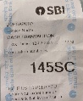

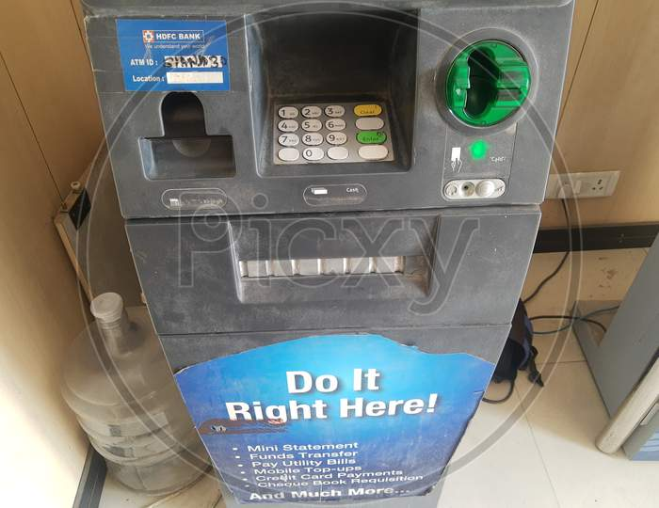
Real life example of App Router
Reception
App Router
Anubhav
1
Single entry point to access all the services of the app. Façade layer. It redirect user to correct services. App router uses a file xs-app.json to know all the services of our app.
2
3
JWT
3
Mycapapp multiple microservices
4
JWT
Loan
XSUAA
Make sure that user is authenticated and authorizations
FDs
Credit Card
4
Auth service
Xsuaa service to verify JWT token
Redirect to
Access service
insurance
4
SAML
IdP
Ask user to prove their identity
5
Locker
*******

Slide 103
Implementing App Router
Navigate to the app directory (app router is implemented with ui module) – cd mycapapp/app
Initialize node application because app router is a node app – npm init
Bring the standard SAP approuter module as part of dependency of this app- npm install @sap/approuter
When we deploy this app to cloud, the approuter should start automatically – “start” in the app/package.json
Tell the approuter about the microservice which we will have inside our app – touch xs-app.json
Documentation for xs-app.json is here
Add the configuration for mta.yaml file to deploy our approuter with ui module, you can use cds up command to package and deploy
##this is our UI module added = fioriui+approuter
- name: mycapapp-ui
type: nodejs
path: app
parameters:
instances: 1
buildpack: nodejs_buildpack
build-parameters:
builder: npm-ci
requires:
- name: mycapapp-auth
- name: srv-api
group: destinations
properties:
name: srv-api
strictSSL: true
forwardAuthToken: true
url: '~{srv-url}'
##end of code

Slide 104
Working with Real-time project – code management
Anubhav, last night my CAP code was stable, this morning I had fight with my wife, I came to office was not in a good mood and I messed up the code with 500 changes, and refresh bas tool. The undo is not working; I pray to god to go back to last night state for my project. Will my prayers work?
How to do version management of the code in local machine VS code or BAS tool.
I have made changes to my code, I want to create a stable version (like a copy) so I can compare the changes I have done recently, I can keep them or discard them from multiple files.
Anubhav, currently I am developing a CAP application for my company, right now to share the code with fellow developers, I am downloading the TAR file and sending email to colleagues to use my project and start work on it. At the end of day, we have piles of email in our inbox with each team member sending their TAR file ☹ how can we merge all the code??
My company is an MNC, we have colleagues working in Denmark, Sweden, New York, Delhi, Gurgaon, Mumbai, Pune, with different time zones, how can we ensure as team to have a stable merged code together. So when a developer comes in the morning to office, can get the latest code changes by fellow colleagues on different zone.
My colleague suddenly emergency leave, my manager asked me to took over the urgent bug fixes in source code, how can I get latest code of CAP project?
How to know Who, When, What time made what changes to the production code, so when a issue comes we can find the right developer to blame.
What is the best practice/gold standard to manage capm projects in real-world company.
I just joined a new company/project on capm with 5x salary, they directly ask me to enhance code of existing cap project, how to get started?
There was a cap project built by EX employees, they left. I was hired recently to manage existing cap apps.
Multiple developers working simultaneously on same lines of code in their dev tool w/o knowing if I am also changing same file, whos change will take priority, how do we resolve conflicts.
I am using VS code, but Alex is using BAS tool in my company, how can we port the code between different development tools.
Clean-desk policy in SAP labs.
Git and Git HUB

Slide 105

Git and GIT HUB
Git – it is a distributed source code repository management system for developers to manage any kind of code, CAPM, ABAP, MDK, Fiori etc. with version management capabilities.
Git HUB – it’s a google drive for developers. It is a central (remote) repository management system for projects.
.gitignore
Local Repository
(a folder in a pen drive)
git init
mycapapp
BAS tool
staging
git add .
Anubhav
git commit -m “write..”
git reset --hard
git reset CID
C1
C2
C3
..
21st march is next session
Main/master

Slide 106
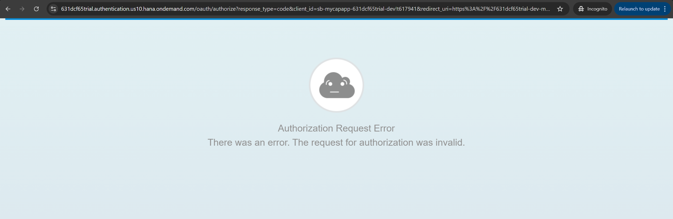
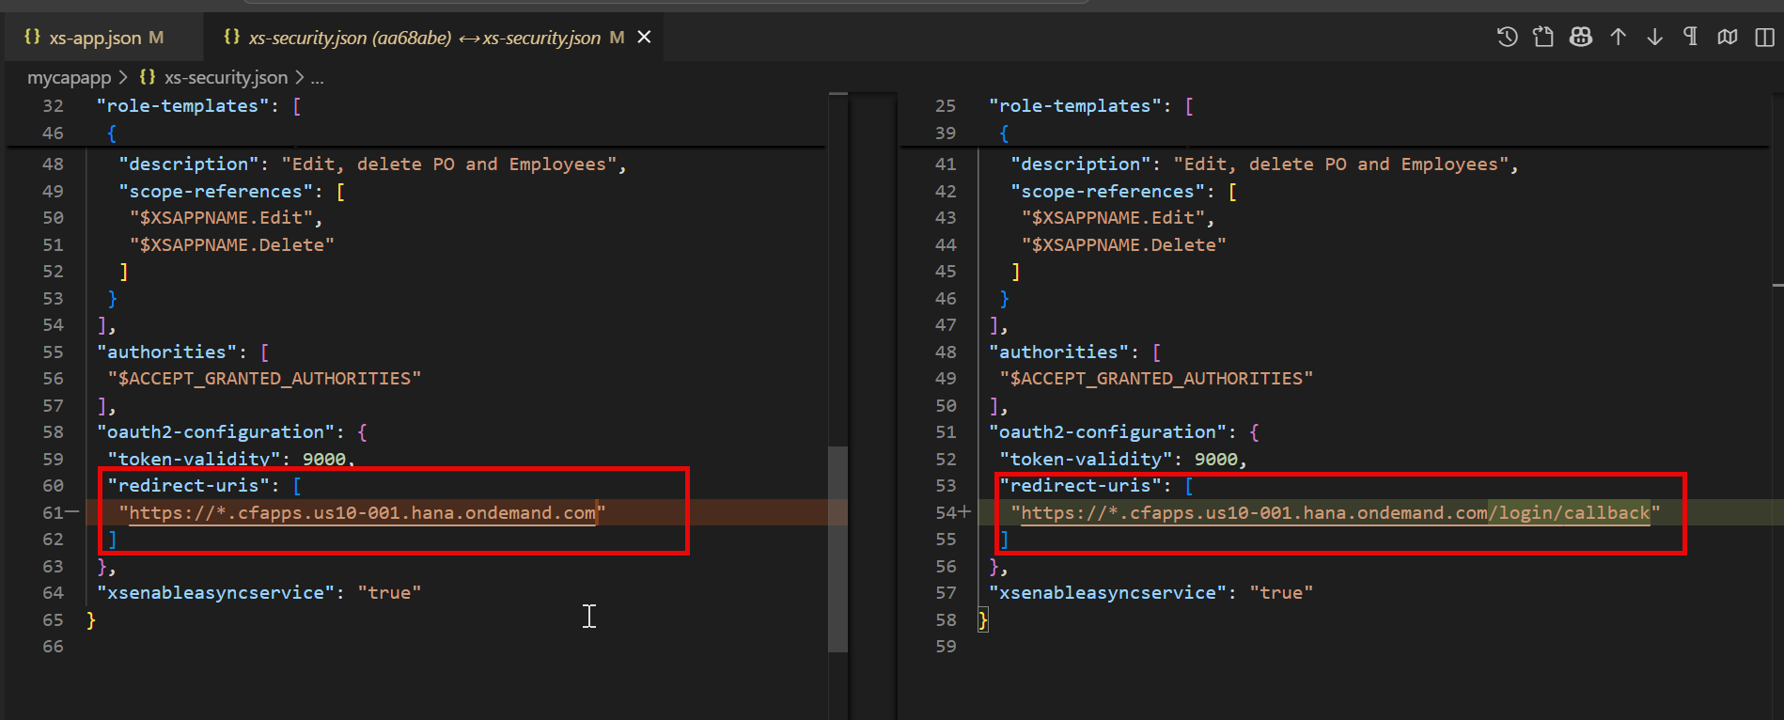
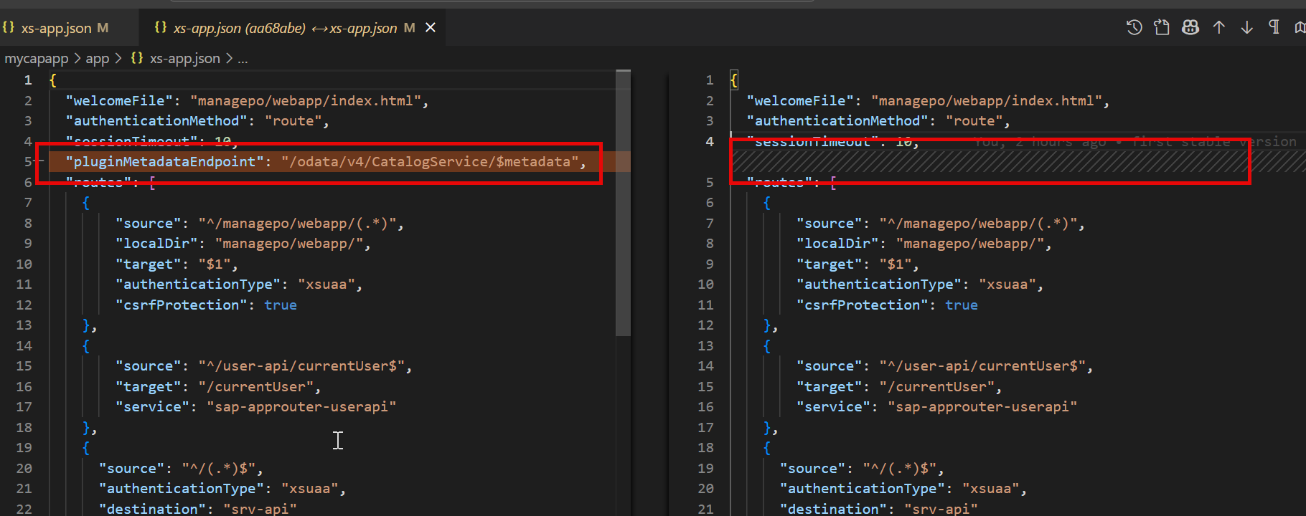
Fixing past issue

Slide 107

Git and GIT HUB
Git – it is a distributed source code repository management system for developers to manage any kind of code, CAPM, ABAP, MDK, Fiori etc. with version management capabilities.
Git HUB – it’s a google drive for developers. It is a central (remote) repository management system for projects.
.gitignore
git add .
git commit -m “write..”
Local Repository
(a folder in a pen drive)
mycapapp
BAS tool
Anubhav
git branch -M master
git remote add origin https://github.com/soyuztechnologies/test_btp_capm_batch2026.git
git push -u origin master
https://github.com/soyuztechnologies/test_btp_capm_batch2026.git
Local Repository
(a folder in a pen drive)
Remote Repository
Git HUB
(a folder in google drive)
mycapapp
git clone URL NAME
cd mycapapp
npm install
cds watch
VS Code
Ananya

Slide 108
Steps
Create a/c on https://github.com/signup?ref_cta=Sign+up&ref_loc=header+logged+out&ref_page=%2F&source=header-home
PAT – Personal Access Token, it works like a password for your git a/c so from dev tools like BAS you can access your repository to upload and download code securely. We now go to settings>Developer Settings>Create Classic PAT token - https://github.com/settings/tokens
Now we create a remote repository (google drive folder)
Now upload the code from local repository to remote repository (git push)
Another developer, e.g using VS code, perform git clone to get the project first time in their dev tool
Make changes, perform commit and push
Others will come in morning, perform git pull

Slide 109
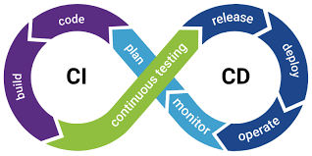
CI/CD
Continuous Integration (innovation) and Continuous Delivery
A development team spend significant time to build, deploy, test, upload code change to dev system – integration
Moving the code to Q and P systems – delivery
To save the time and automate this process is called CI/CD. It reduces manual effort and also reduces changes of bugs at later stage in SDLC. In past sap used to rely on a tool called Jenkins to automate the CI/CD process. Now, SAP directly offer specialized services in BTP for CI/CD.

Slide 110


Process
Job (pipeline)

Slide 111
CTMS – Cloud Transport Management Service
Manages the transport of software changes across multiple BTP spaces/subaccounts/landscape (D🡪Q🡪P)
Provides governance/traceability of application versions and configurations
Can be linked with our CI/CD service to connect with a Job that can fully automate code to move to Q and P
We can configure Approval workflows, System landscapes, rollback mechanisms, transport control
Increase consistency, compliance and control for multi-environment deployments
Automate build, test, and deployment of our MTAR apps to BTP
Enables the CI and CD to streamline software updates and reduce manual effort
Works well with git repositories in full automation mode to get latest code changes done by developers
Offers ready to use pipelines for SAP technologies like CAP, RAP, Build..
Reduces manual effort, increase code quality and hence accelerates dev cycle
CICD Service

Slide 112
Steps
Subscribe to SAP BTP CICD Service
Subscribe to SAP BTP CTMS service
We need to grant the role to ourself to use these subscriptions so we can configure pipelines
Create a role collection which will be granted to decision maker in my company to decide whether a transport created by dev team allowed to be imported to Q and P
Create Spaces in BTP a/c, These spaces can exist in different subaccount also or in same subaccount.
Note down the unique space IDs –
  We need to inform HANA DB to be allowed used by these spaces
  Create special destination (connection) so CTMS can upload the code to these spaces docu
qlt - 112f4a91-bc3b-4e7d-8d9b-79431095a306
prod - 179155c7-6dfd-4891-8ff0-437a897e6446

Slide 113
Title
https://cockpit.hanatrial.ondemand.com/trial/#/globalaccount/46a34875-3b04-4a13-bc2c-011b3b49216f/subaccount/2402a546-4750-4a83-bccb-e5665b1d7dd0/org/115b6ee0-a7b2-43ab-b9b6-2391e45fd698/space/112f4a91-bc3b-4e7d-8d9b-79431095a306
https://cockpit.hanatrial.ondemand.com/trial/#/globalaccount/46a34875-3b04-4a13-bc2c-011b3b49216f/subaccount/2402a546-4750-4a83-bccb-e5665b1d7dd0/org/115b6ee0-a7b2-43ab-b9b6-2391e45fd698/space/179155c7-6dfd-4891-8ff0-437a897e6446/applications
qlt - 112f4a91-bc3b-4e7d-8d9b-79431095a306
prod - 179155c7-6dfd-4891-8ff0-437a897e6446
https://deploy-service.cf.<domain>/slprot/<my-space-guid>/slp
https://deploy-service.cf.us10-001.hana.ondemand.com/slprot/<my-space-guid>/slp
QLT
https://deploy-service.cf.us10-001.hana.ondemand.com/slprot/112f4a91-bc3b-4e7d-8d9b-79431095a306/slp
PROD
https://deploy-service.cf.us10-001.hana.ondemand.com/slprot/179155c7-6dfd-4891-8ff0-437a897e6446/slp

Slide 114
Steps Continued… CTMS
Configure the system landscape for Q and P systems with name (is important) and using our destinations
Create CTMS instance-based service and service key and note down service key in a notepad
Launch the CI/CD Subscription
Maintain the credentials to our BTP a/c so once the code build (mta build), CI/CD service can send code to dev space (earlier we were doing it manually)
Maintain the credentials as service key of CTMS service so the CI/CD service can contact the CTMS service to initialize a cloud transport for Q and P
Maintain our Git Repository from where the code needs to be downloaded
Whenever a developer Push the code to git repo, it has to create a signal to our CI/CD engine to download latest code and do a automated build of mtar. To achieve this connection, we use webhook. Create webhook in CI/CD and register the same with our repository in git hub.
Create a job, define the repo, provide credentials of our a/c and link with ctms service for uploading tr
Perform a push to repo and build was triggered
A transport was created and we imported the TR to Q system
If success, a TR will be created for P system

Slide 115



Process
push
Btp-cred
C I C D Subs
Ctms-cred
Job (pipeline)
BTP Account
ctms
Dev
CTMS
Qlt
qlt
prod
destinations
Prod

Slide 116
Question
In my company we have a team which is responsible for managing the CAP application which includes Database tables, CDS views, Services. But we have a separate team that manages the UI (Fiori team), what do you recommend, shall we give access to our CAP project to that time so they can add their UI in our app folder?
As a company we write business logic and DB layer in CAP project, Over the time, the business logic and DB is finalized and does not attract many changes. However the UI keeps on changing, The problem is if we keep the ui module in CAP project, we have to rebuild everything, everytime. We want to decouple UI and components of our applications. Is it possible?
There are several teams in my company wants to build UI on top of my CAP service, what is the best practice.
I don’t want many many UI projects inside my cap app because it will make my project very bulky, how can we handle a decoupling of UI and CAP service?

Slide 117
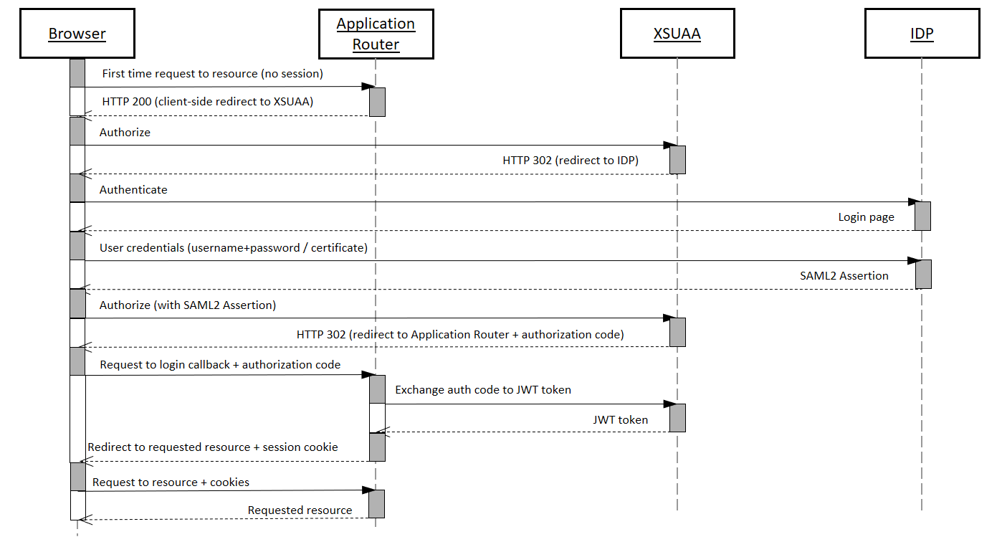
Title
Text

Slide 118
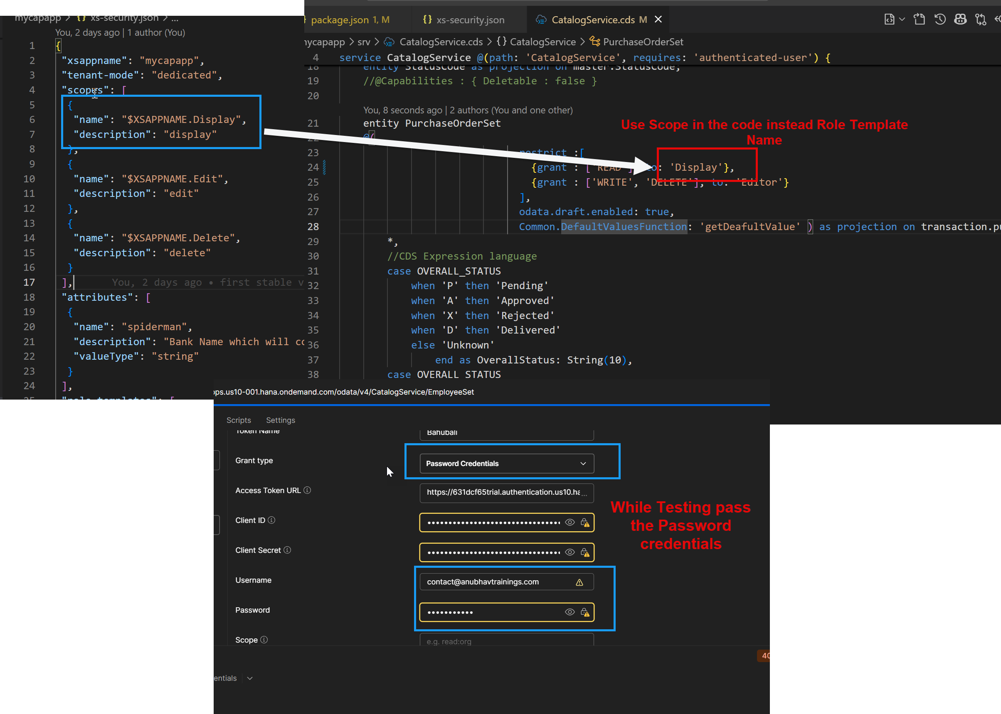
Fixing Authorization issue
Text

Slide 119
Title
Hi Anubhav, when we have multiple FIoRI apps in the same capm service,
we have to create roles for all the FIoRI apps in the same xs-security.json and have to assign it to relevant app users right ?
Since these are independent apps, the security also needs to manage independently. Each app has its own xs-security file.
Also when we build multiple fiori apps, we will have multiple ui micro services for the same cap app right ?
No, CAP app has its own microservice. You have these loosely coupled Fiori apps which are indepent apps.
cds outbox messages pls show us how we can have different message displayed to the user.I checked in the google,but couldn't find example on it
Let me explore and come back ☺
one doubt regarding HDI microservice.with CICD and CTMS we are anyway deploying in Dev again and then release to QA. Can we avoid manual deployment first ( Mickey service ) .
Yes, you can but if you don’t do mickey, how you test whether your app after deployment will work with HANA or not?
Use CTMS to deploy in dev as well , test and then release to QA. is there any disadvantage if we do this way.
No

Slide 120
Fiori on Cloud Recipe ingredients 3X3
Modules
Our application (html5 module) – it is our actual Fiori app, when we build the mta_archieve, this will also package all the Fiori app content in a zip file.
HTML5 Content Deployer (app content)– this module will be used to take the zip file of our Fiori app and usage the html5-repo-host service and store our app in BTP HTML5 Repository.
Destination Content – The module will use the destination service and creates the destination for html5-repo-host service and auth (xsuaa) service which later will be used by managed app router hence by build workzone and our app.
Resources
html5-repo-host service – this will be used by Build workzone and managed app router to load our Fiori app deployed in html5 repository @ Runtime when user tries to load our app.
Destination-service – this service will contain all the destinations inside and help app and managed app router to locate other services @ Runtime
Auth service (xsuaa) – so our app can call the XSUAA for JWT token for authentication.
Managed App Router (built-in in BTP) – it is a built-in, FREE, app router provided by SAP in BTP. Which is responsible to communicate between all microservices of our Fiori UIs. It is used by build work zone (Fiori Launchpad). There is also a successor of managed app router called as Application frontend service.

Slide 121
What is more…
In order to see the deployed Fiori apps in BTP under HTML5 Applications, it is mandatory to have SAP Build work zone subscription.
In order to have a successful Build workzone subscription, you need SAP Cloud Identity service subscription.

Slide 122
SAP Cloud Identity Service
SAP BTP CIS are the group of service, which enable us to integrate identity and access management between systems and for the BTP account. The goal is to provide a seamless single sign-on experience across multiple systems and apps. While ensuring that systems and data access is secure.
Also work like a user store for your business users in the company.
Cloud identity service includes
Identity Authentication
Identity provisioning
Identity Directory
Authorization management for business users

Slide 123




Persona
BTP Admin (Anubhav)
BTP Developer (Anubhav)
Application Admin (Subbu)
Business users (Raj, Sonia, Rob, Sajeev, Bhagya)
Subscribe to different services
Configure entitlements
Create Subscriptions
Create Roles
Manage Users in company
Manages environment, spaces
Create destinations
Configure Landscape in CTMS
Configure SAP BTP Cloud Identity service and Appoints Subu as Application Admin
Create Trust Relation between Cloud Identity Service and BTP Sub Account
Use BAS tool
Create Fiori on Cloud App
Create CAPM app
Deploy App
Push code to git
Configure Backing service
Testing and deployment
Manage Applications
Configure tiles for Build Workzone
Admin for Business users
Create Application role
Create Role Collections
Register business users
Reset their passwords
Configure Company SSO with BTP
Grant Role Collections to business users
Give access to Build workzone app to business users
Grant Fiori App Access to business users
They are using actual apps in their respective departments
Create Sales order
Create purchase order
Manage Service contract
….

Slide 124
Persona
BTP Admin (Anubhav)
BTP Developer (Anubhav)
Application Admin (Subbu)
Business users (Raj, Sonia, Rob, Sajeev, Bhagya)
Subscribe to different services
Configure entitlements
Create Subscriptions
Create Roles
Manage Users in company
Manages environment, spaces
Create destinations
Configure Landscape in CTMS
Configure SAP BTP Cloud Identity service and Appoints Subu as Application Admin
Create Trust Relation between Cloud Identity Service and BTP Sub Account
Subscribe to SAP Build Workzone and give access to developer and also to App Admin
Send email to Subu for build workzone
Use BAS tool
Create Fiori on Cloud App
Create CAPM app
Deploy App
Push code to git
Configure Backing service
Testing and deployment
Manage Applications
Configure tiles for Build Workzone
Already created a Fiori on Cloud Application, Will deploy this app to BTP in HTML5 Repository
Admin for Business users
Create Application role
Create Role Collections
Register business users
Reset their passwords
Configure Company SSO with BTP
Grant Role Collections to business users
Give access to Build workzone app to business users
Grant Fiori App Access to business users
Receives email and access SAP Build Work zone
Login to BWZ and configure a site
Fetch the apps deployed by deb to html5-repo
Check slide
They are using actual apps in their respective departments
Create Sales order
Create purchase order
Manage Service contract
….

Slide 125
How to configure Build Workzone
Receives email and access SAP Build Work zone
Login to BWZ and configure a site
Fetch the apps deployed by developer to html5-repo from the channel manager
Go to content explorer>HTML5 Explorer> Import the app for the user in the Content Manager
Import the app to the Content Explorer and the app is now available [ToDo: Next session Anubhav has to show our deployed html5 app instead the mock app]
Create a catalog – Collection of tiles, Add all apps to the catalog and save
Create a group – Providing meaningful grouping of apps for easy navigation e.g. Employee, Manager etc.
Create a role – once granted to our business users they can access the app
Open the site settings, and perform role assignment to the site
----
Registers the business user
[BU] Receives and email and activates his/her SAP account with SAP Custom Idp (Cloud Identity Service)
Grant the business user access to our Role and Launchpad external user role so they can access our apps
Share the link of the business site with the user which when they open, they can consume applications.
[BU] Goes and access the launchpad (site)
https://help.sap.com/docs/cloud-identity-services/cloud-identity-services/configure-idp-initiated-sso
https://help.sap.com/docs/btp/sap-business-technology-platform/developing-with-sap-cloud-application-programming-model

Slide 126
MBT Tool for local system
https://github.com/SAP/cloud-mta-build-tool?tab=readme-ov-file
https://sap.github.io/cloud-mta-build-tool/

Slide 127
Support for attachments
Often we want to enable upload of documents and store in cloud with our CAP application. SAP already offer a attachment plugin which can be used.
It creates a database table called Attachment for you to store all attachments
When user uploads attachment, the plugin also does virus scan
Supports all kinds of attachments like pdf, images, word, ppt, etc.
Little development effort
https://cap.cloud.sap/docs/plugins/#attachments
Requirement:
Along with PO, we want to enable user to upload multiple attachments. Like user can upload the reference quotation of vendor, additional documents, required approval screenshots of PO etc.
https://www.npmjs.com/package/@cap-js/attachments

Slide 128
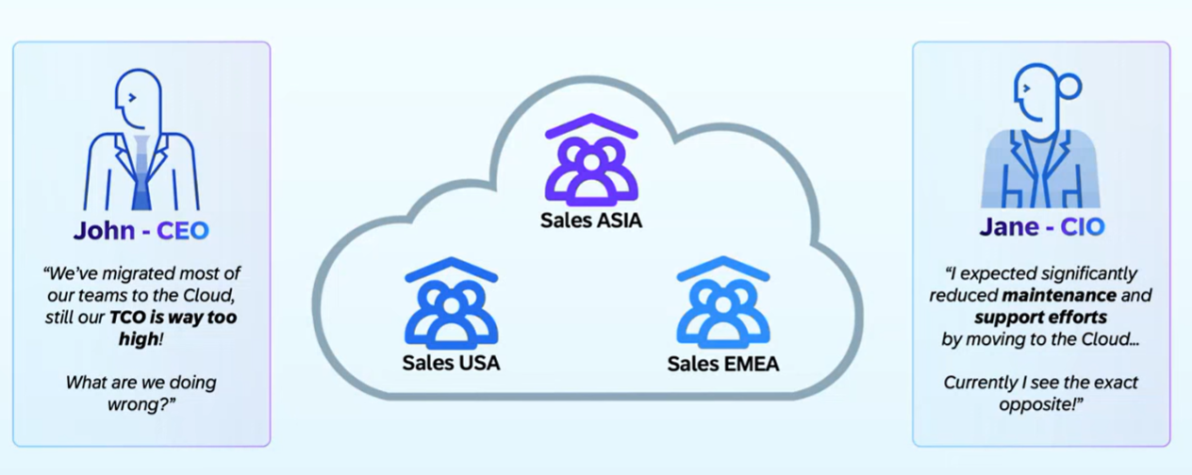
Why Multi-tenant App?

Slide 129
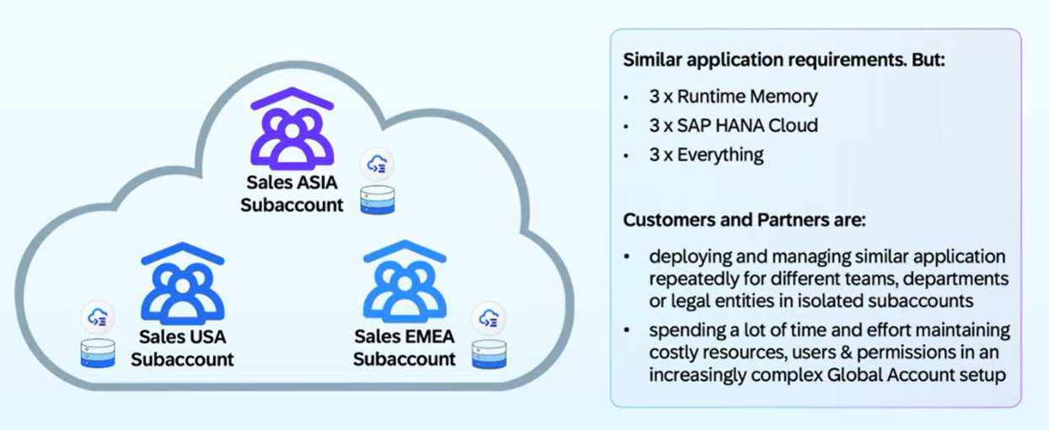
Common Challenges

Slide 130
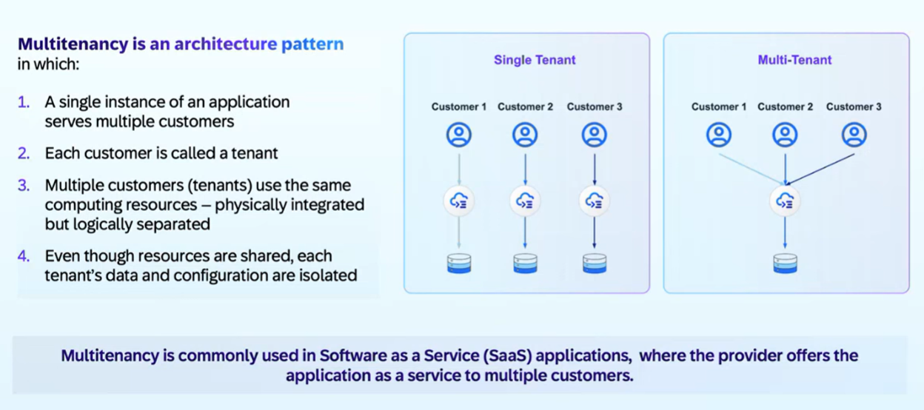
What is Multitenant - SaaS

Slide 131
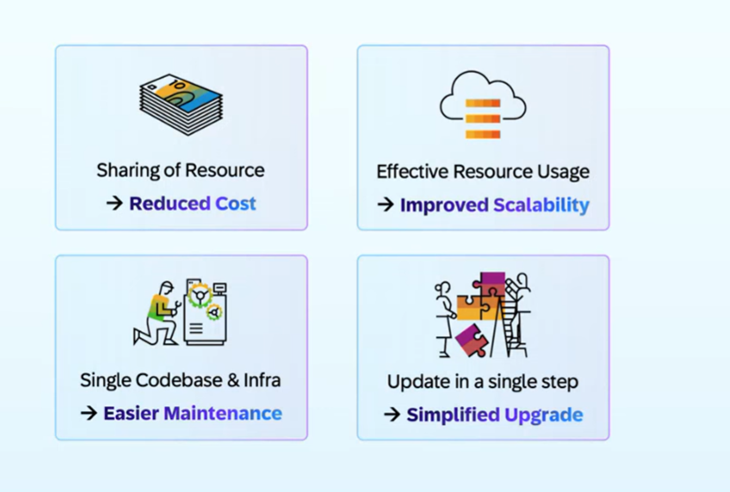
Benefits of Multi tenant App

Slide 132
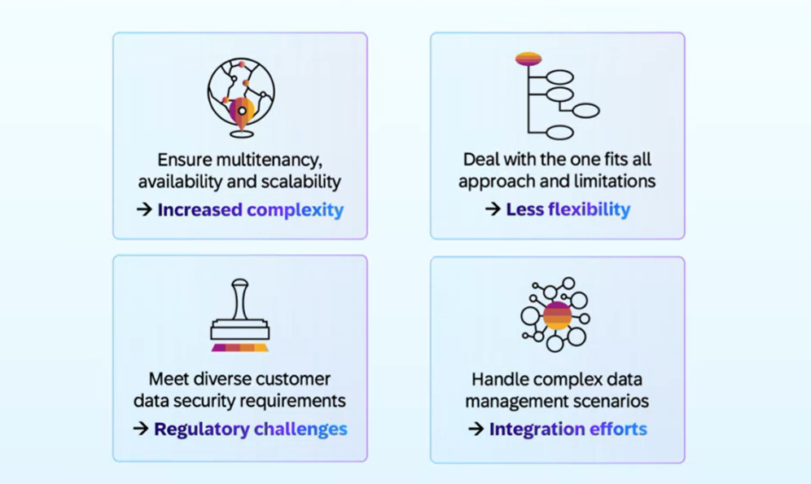
Challenges

Slide 133
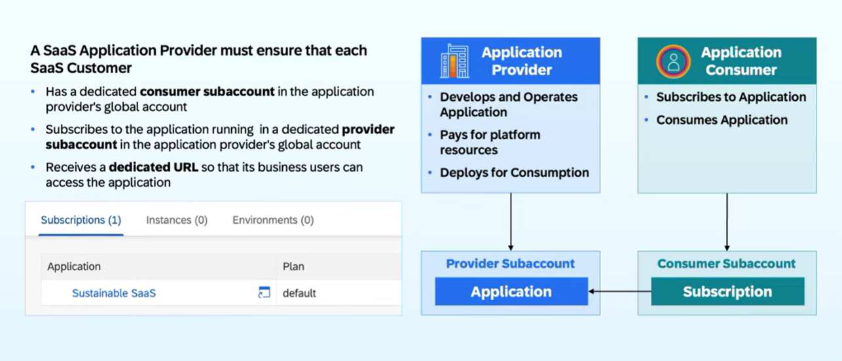
How it works in BTP?

Slide 134
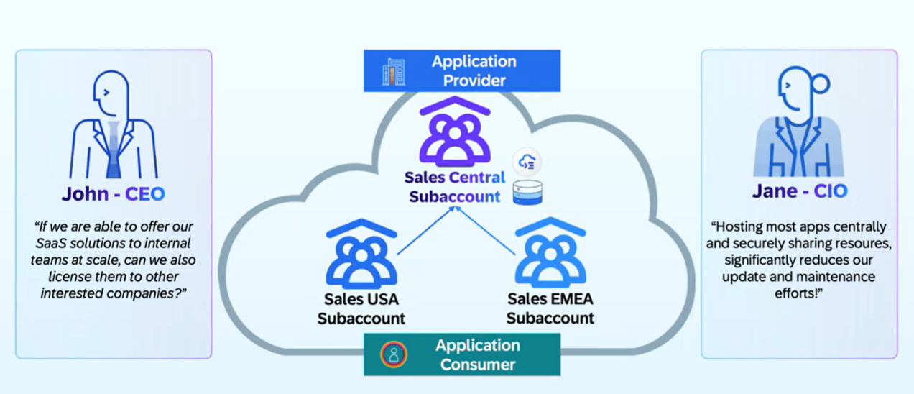
SAP Customer Perspective

Slide 135
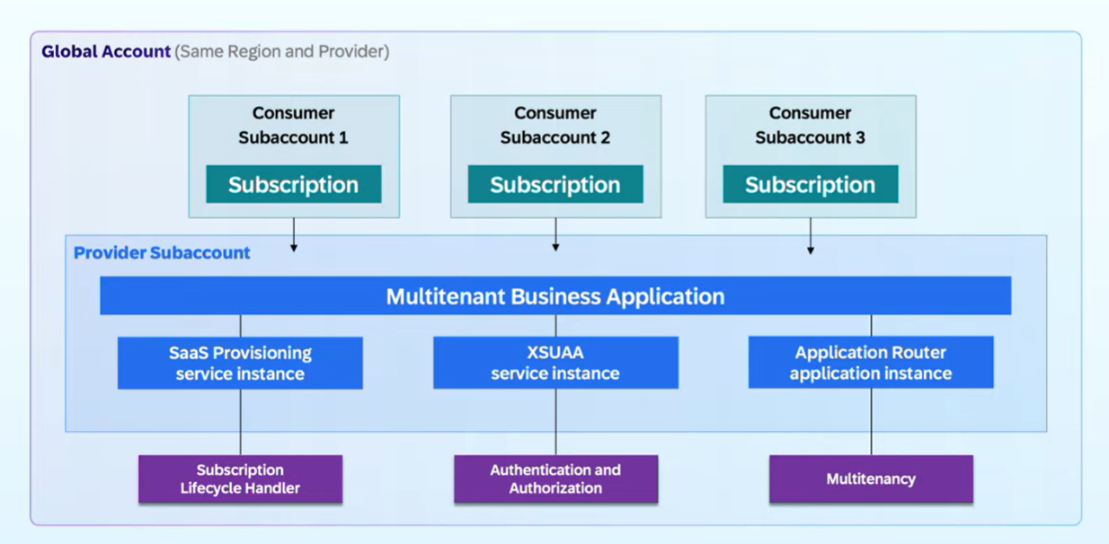
Multi-tenant App on BTP

Slide 136
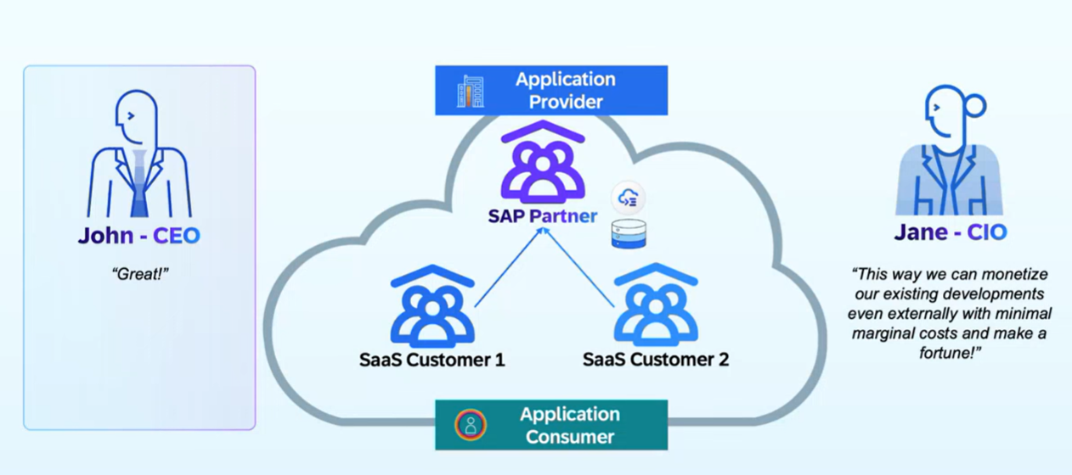
Partner Solutions

Slide 137

Data Separation for Multi tenant Apps

Slide 138

SAP BTP Offerings

Slide 139

Multi Tenant App – Architecture with CAP

Slide 140
Simple Analogy
Think of a restaurant:
- Main Restaurant = Your main CAP application (serves customers/tenants)
- Back Office/Manager's Office = MTX Sidecar (handles tenant registration, upgrades, configuration)
The restaurant needs the back office, but they are separate rooms doing different jobs.
In SAP CAP Context
When you build a multitenant SaaS application, you have:
1. Main Application (Your Business Logic)
- Serves actual business requests
- Handles data from different tenants
- Example: An invoice management app
2. MTX Sidecar (Tenant Management Service)
- Handles tenant onboarding
- Manages database schema upgrades
- Handles extensions
- Example: When a new customer subscribes, this service sets them up

Slide 141
What Happens in Real Life – Customer Side
Scenario: New Customer "Acme Corp" Subscribes
1. Acme Corp clicks "Subscribe" in BTP
2. MTX Sidecar (`mtx-sidecar` profile) receives the request:
- Creates database schema for Acme Corp
- Sets up tenant configuration
- Deploys data model
3. Main App (`with-mtx-sidecar` profile) just serves requests:
- When Acme users log in, it serves their invoices
- It doesn't worry about tenant setup - the sidecar already did that
Simple Rule:
- `mtx-sidecar` → Use this for the SERVICE that DOES the tenant management work
- `with-mtx-sidecar` → Use this for your MAIN APP that USES the tenant management service

Slide 142
Profiles
In BTP CAP (Cloud Application Programming Model), the difference between `with-mtx-sidecar` and `mtx-sidecar` profiles relates to how the MTX (Multitenancy and Extensibility) services are deployed:
`mtx-sidecar` Profile
This profile is used for the MTX sidecar application itself. It:
- Defines the configuration for the separate microservice that handles multitenancy operations
- Contains the MTX server implementation that manages tenant subscriptions, upgrades, and extensions
- Is applied to the dedicated MTX sidecar service/module in your deployment
Usage: Applied to the MTX sidecar service definition in your `mta.yaml` or deployment configuration.
`with-mtx-sidecar` Profile
This profile is used for the main application service when it's deployed alongside an MTX sidecar. It:
- Configures the main CAP application to work with an external MTX sidecar
- Delegates multitenancy operations to the sidecar instead of handling them internally
- Sets up the proper service bindings and configurations to communicate with the MTX sidecar
- Disables built-in MTX capabilities in the main app since they're handled by the sidecar

Slide 143
Example MTA.yaml
```yaml
modules:
- name: myapp-srv
type: nodejs
parameters:
buildpack: nodejs_buildpack
properties:
CDS_FEATURES_WITH_MTX_SIDECAR: true or use with-mtx-sidecar profile
requires:
- name: myapp-mtx
- name: myapp-mtx
type: nodejs
parameters:
buildpack: nodejs_buildpack
properties:
CDS_FEATURES_MTX_SIDECAR: true or use mtx-sidecar profile
```

Slide 144
Step by Step – Multi tenancy
CAP has built-in support for multitenancy with @sap/cds-mtxs package. Essentially, multitenancy is the ability to serve multiple tenants through single clusters of microservice instance (srv,db,approuter,fioriapp), while strictly isolating the tenant specific data. E.g. you working for tata group and you created one cap app for all group of companies like tata motors, tata tea, tata consultancy service. Tenants are clients using SaaS Solution and subscribing it using BTP consumer account. The application is deployed in provider account.
In contrast to single-tenant mode, applications wait for tenants to subscribe it before they start using it. Simply we can enable multi tenancy in cap applications using cds add multitenancy command. Next we download the module which is added npm install
We check the mta.yaml, system has automatically added a app router for us, however we already have app router with our ui module so we cut the necessary properties like TENANT_HOST_PATTERN, mtx-api, and provides sections and added to our app router, and we removed the auto generated app router. System removes DB deployer, because now the sidecar-mtx application will manage your tenant database (hdi container).
Before deploying to cloud, lets do a test drive common SaaS operations with app locally, including start for MTX app (Mall management to open the mall, clean, allow customers to security scan), start the app (actual Nike shop), we will onboard the tenants (e.g. t1, t2). We enhance mock user strategy with tenant name.
In terminal 1, We will now start the on-boarding side car app cds watch mtx/sidecar 🡪 4005
In terminal 2, We will start the actual multi-tenant app cds watch --with-mtx 🡪 4004
In the third terminal 3, we subscribe app to tenants – cds subscribe t1 --to http://localhost:4005
Subscribe same app for tenant 2 - cds subscribe t2 --to http://localhost:4005

Slide 145
Continue
After local test was success, we build the project using mbt build
Go inside the mta_archieves folder and cf deploy MTAR_address
We create another subaccount (consumer1) in same data center/provider. Consumer will search our multi tenant app (like sap standard apps sac, s4hana, ds, bdc, sf, bas) and subscribe. Behind the scene a container gets created immediately
The Provider has to add a route of your subdomain in their space.
The consume Admin has to create Role collection and grant permission of multi teant app to their Employees.
Employees gets a link with which they access our app.

Slide 146

Analytics list page
Text

Slide 147
Analytics list page
Text

Slide 148
Use Case- Analytics
Design a Purchase order analytic application.
Search bar – companyName, country, Purchase order Id, ProductDescription, Currency Code
Visual Filter – Chart as visual filter for country based total sales
Main Chart – Company Wise total sales in a Bar chart (Multiple axis to create a stack bar chart)
Table – Shows PO Id, Company Name, Gross Amount, Product, Currency Code, Country

Slide 149

11
www.anubhavtrainings.com

Slide 150


Slide 151

Looming threats

Slide 152

How to be Fast
11
www.anubhavtrainings.com

Slide 153
Clean Core
Clean means up-to-date, documented, unmodified, consistent, efficient and upgrade ready.
S/4HANA cloud Private Edition (On-premise) 🡺 GUI Access, Full control on your system including SPRO, BADIs and custom development, postpone upgrades, Full access to code and chances of even modify standard SAP code.
85-90%
S/4HANA Cloud Public Edition 🡺 Shared Environment, Standardized ERP solution one for all customers, customers cannot postpone upgrades, they cannot have SAPGUI or full access to system, Fiori only approach for accessing business applications, Force upgrade (always clean) – 10~15%
Hybrid – both.
Rise with SAP – for large corporations SAP offering a conversion to S/4HANA + BTP + SAC + DS…

Slide 154
Benefits
Access to innovation – Since your SAP S/4HANA system is not contaminated with custom code, the moment SAP comes with new Release, they can be applied immediately
Upgrade Simplicity – We can upgrade stress free.
Lower TCO – Since we follow clean core, we actually are safe from changes which upgrade brings, so SAP parters can offer an upgrade at fix cost.
Enhanced Security – you don’t need to on-board every dev in system, because they can use BTP for dev.
Improved performance – Core is clean, it does not have to interact with lots of custom code, Store your custom code in git with BTP.
Data Simplification – Which data is private, which is public.

Slide 155

Elements of Clean Core
11
www.anubhavtrainings.com

Slide 156

High Level Guidence
<content>
https://youtu.be/n0oS1eiOWU0
11
www.anubhavtrainings.com

Slide 157

Detailed Journey
11
www.anubhavtrainings.com

Slide 158
What is API
It is a contract between 2 parties. Consumer(caller) and provider.
API provides
a single point of contact to extract, update data in systems
Hides all the complexity and technical implementation behind the scenes
These APIs remains stable release-on-release
SAP Accelerator HUB (earlier API HUB)
https://api.sap.com

Slide 159
Use Case
Design and develop a clean-core solution in BTP to consume VBAK,VBAP (Sales order) data from my company S/4HANA system. The solution usage upgrade stable api for sales order 1.1.1 to read, and create sales order. Using CAPM we will consume this API.
Pre-requisites:
SAP S/4HANA System – Anubhav training offers an SAP S/4HANA fully activated on-premise system which installed in our own private cloud (AWS). No VPN is required to connect to this SAP system. You can add it to your SAPGUI of office or home laptop (we are also providing free gui). We will share a detailed guide,videos to add server to your local machine. All Anubhav’s courses in single server. No Cloud Connector Required also to connect to BTP system. 3000 INR / 50 USD per month per user.
Send email to server@anubhavtrainings.com
Hello Team,
I want SAP S/4HANA system access, please share the cost in INR currency and details to transfer. Thanks.
S/4HANA Cloud SDK (JavaScript) - FREE from SAP.

Slide 160




Title
Text

Slide 161
Steps
Always recommended to explore the API first which you plan to consume and make sure its active. If the API is not active, you have to go to /n/IWFND/MAINT_SERVICE tcode in your company SAP system.
If you plan to insert, update, delete data, create a postman collection to test api and get comfortable with the contract. Test if everything is well understood, before building clean-core app.
[Not Required for Anubhav Training system] if you are using your company system, you also need to configure SAP Cloud Connector which is a free software to bypass your company firewall. https://www.youtube.com/watch?v=6jk9G4vaFjQ
First check the host name and port no for your sap system in SMICM.
Create a connection to our Company SAP S/4HANA system by creating a destination in BTP. Now we create a destination in BAS tool.
Initialize your S4HANA side by side extension app
mkdir s4hext
cd s4hext
cds init
npm install
Now we download the specification of SAP API which we plan to consume in our app. Go to api hub and download edmx file for the api.

Slide 162
Cotinue…
Upload the edmx file into srv>external folder
Run below command to generate csn (CDS schema notation), the structure which is needed to build our entities using standard entities of this service. cds import srv/external/OP_API_SALES_ORDER_SRV_0001.edmx
Check SDK Documentation - https://sap.github.io/cloud-sdk/docs/js/features/odata/generate-client
Install SDK generator module to create boilerplate code - npm install -D @sap-cloud-sdk/generator
Also install the SDK V2 module needed to run odata v2 from SDK - npm install @sap-cloud-sdk/odata-v2
Now we create boiler plate code - npx generate-odata-client --transpile --input srv/external --outputDir srv/src/generated
Explore the generated folder service.js file to look at classes and api functions it created
Next, we define the CAP API for working with sales order data of S/4HANA – CatalogService.cds

Slide 163

Destination for Anubhav Training system
http://S4HANA10.saraswatitechnologies.in:8010

Slide 164
Cotinue…
Upload the edmx file into srv>external folder
Run below command to generate csn (CDS schema notation), the structure which is needed to build our entities using standard entities of this service. cds import srv/external/OP_API_SALES_ORDER_SRV_0001.edmx
Check SDK Documentation - https://sap.github.io/cloud-sdk/docs/js/features/odata/generate-client
Install SDK generator module to create boilerplate code - npm install -D @sap-cloud-sdk/generator
Also install the SDK V2 module needed to run odata v2 from SDK - npm install @sap-cloud-sdk/odata-v2
Now we create boiler plate code - npx generate-odata-client --transpile --input srv/external --outputDir srv/src/generated
Explore the generated folder service.js file to look at classes and api functions it created
Next, we define the CAP API for working with sales order data of S/4HANA – CatalogService.cds
Created the CatalogService.js file with required generic handlers
Created .env file to maintain server URL, USER, PASSWORD, installed dotenv module
Also install the moment module to perform date mapping with outgoing data
cds watch to perform local testing

Slide 165
Title
In order to test our app from BAS tool with destination in account to make sure the happy path works before deploying the app. We need to remotely bind the destination service with our app
cf create-service destination lite mydest
cf create-service-key mydest mydest-key
cds bind -2 mydest:mydest-key
cds watch --profile hybrid
The above process ensure that our destination is healthy.
When we deploy app, the destination server will also be created automatically, using mta.yaml. So when app react to cloud dev, qlt and prod, the destination service will auto create like xsuaa service.
We added following support – cds add hana, cds add xsuaa, cds add approuter, cds add mta
Added boilerplate code in xs-security.json fole
npm install, mbt build, cd mta_archieves, cf deploy <MTAR Address>

Slide 166
External API using CAP
Download the metadata of external API - https://services.odata.org/Experimental/OData/OData.svc/$metadata
Upload the edmx file to our CAP project in external folder
cds import to create csn

Slide 167
www.anubhavtrainings.com
FAQs
Do I need to have prior knowledge of SAP BTP or Cloud Foundry?
No, We will cover the Cloud Foundry and BTP foundation in this course for you.
How much Node JS knowledge is required to learn BTP Course?
Only Basic programming skills are required, We will cover basics of Node JS for you along with Tools.
I am an ABAP Consultant; Can I learn SAP BTP ?
Yes, you must, because for all the future cloud projects, we need the knowledge of SAP BTP – Development Track
How much deep knowledge of BAS is required?
No prior experience is required, we will cover setup and administration of VS Code and BAS tool in the course.
What about server access?
The server is Free from SAP for 90 Days, We will use SAP BTP Trial Account for all the activities along with tools like Cloud Foundry CLI, VS Code, MBT which are free. For Deployment we will use productive Accounts.
Would you cover Clean-core and Side by Side Extension scenario in BTP training?
Yes, we will use SAP standard Sales order API from API HUB to build side-by-side application in BTP.
9

Slide 168
www.anubhavtrainings.com
FAQs
Do we also cover Cloud Connector and Cloud Application Security in the course?
Yes, we will cover both topics including application security like XSUAA, Managed and App Router, HTML Repos etc. We will cover concepts of Backing services, service keys and sap BTP cloud offerings.
How of this course do we spend time on CAPM?
We will spend almost 50% time on CAPM framework including basics of Node JS in the course. We will be using Node JS for CAP development.
Do I need prior OData Service experience?
No, we will provide one complimentary OData session
Can I also take the course in video mode as the times do not suit me?
Yes, You can even check the video after the class
What tools do I need to practice in the course?
Business Application Studio + VS Code + Cloud Foundry CLI.
How to join this course?
Email us at contact@anubhavtrainings.com for signing up!
10

Slide 169
Thank you
Anubhav Trainings
Power your career with amazing training content on
SAP Build Process Automation
Build Apps
Generative AI
BDC
Analytics Cloud
RAP
ABAP on HANA
SAP UI5 and Fiori
EMAIL
WEBSITE
contact@anubhavtrainings.com
www.anubhavtrainings.com

